Slide 2
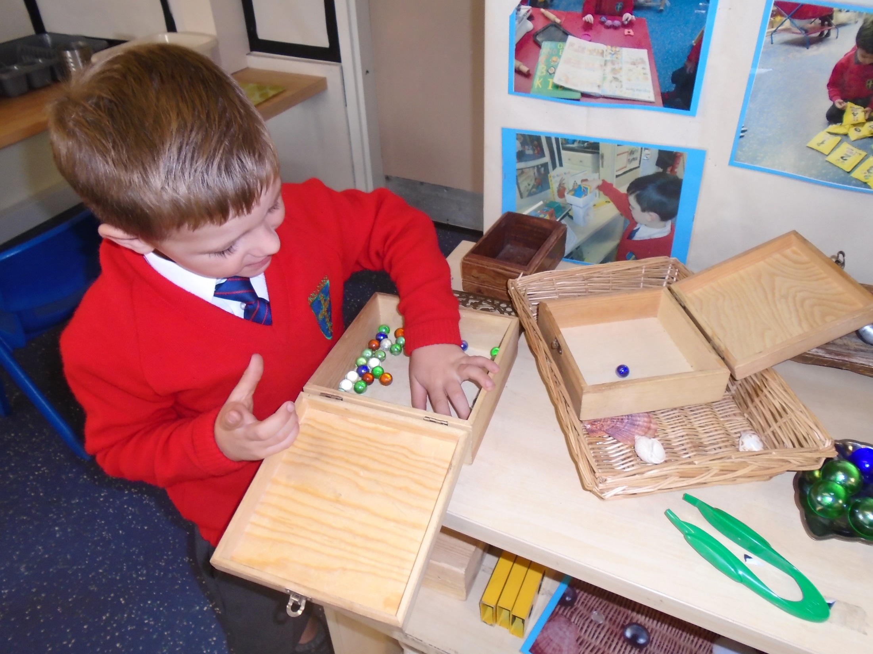
Counting and estimating…
How many? One more? One less?

Slide 3
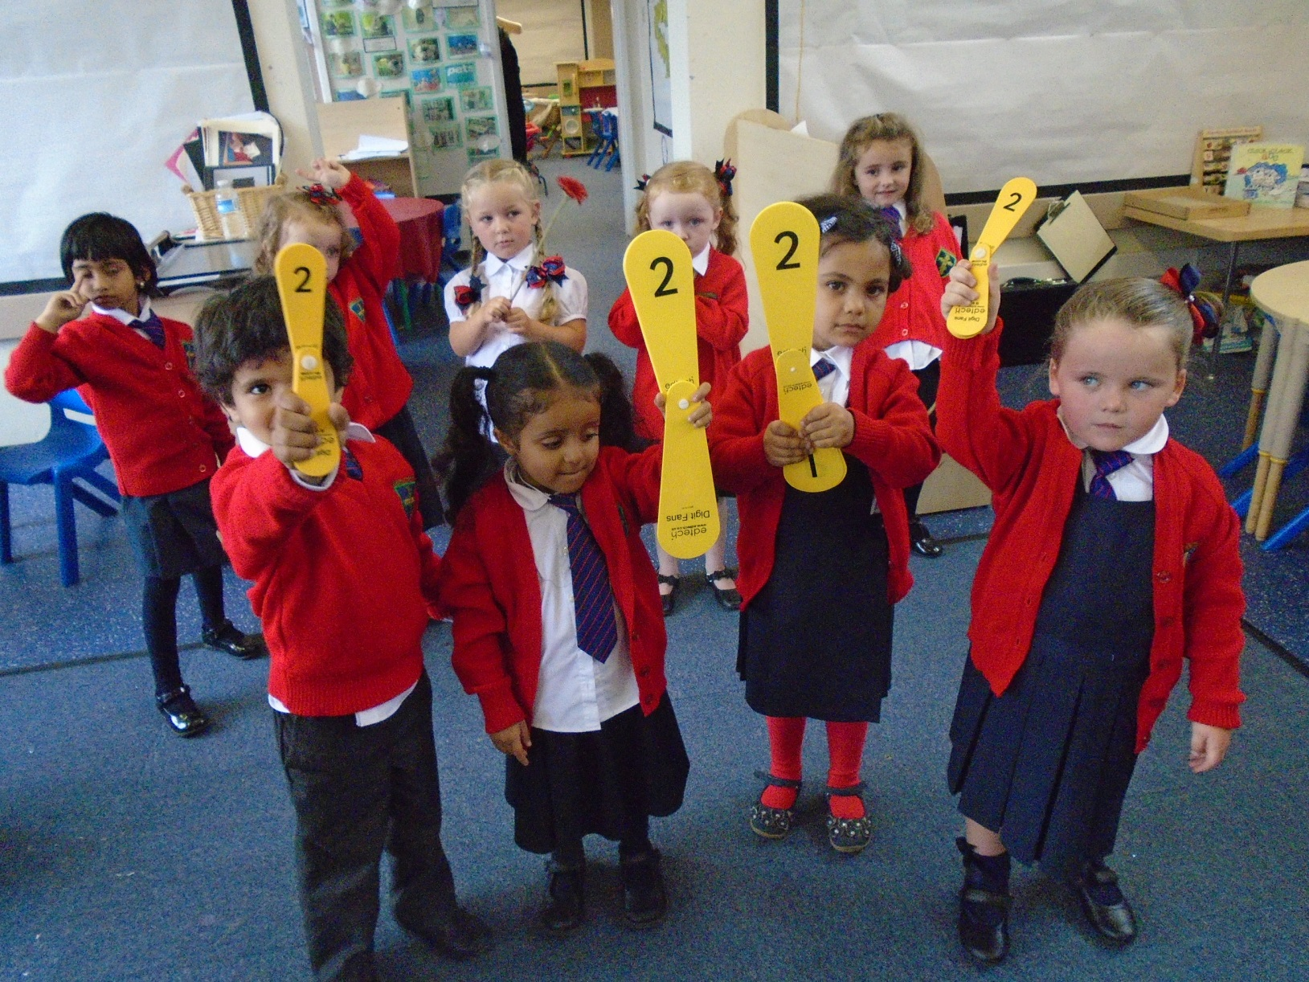
Identifying numerals to 5, then 12,
then 20 and beyond.
Number songs and number fun!

Slide 4
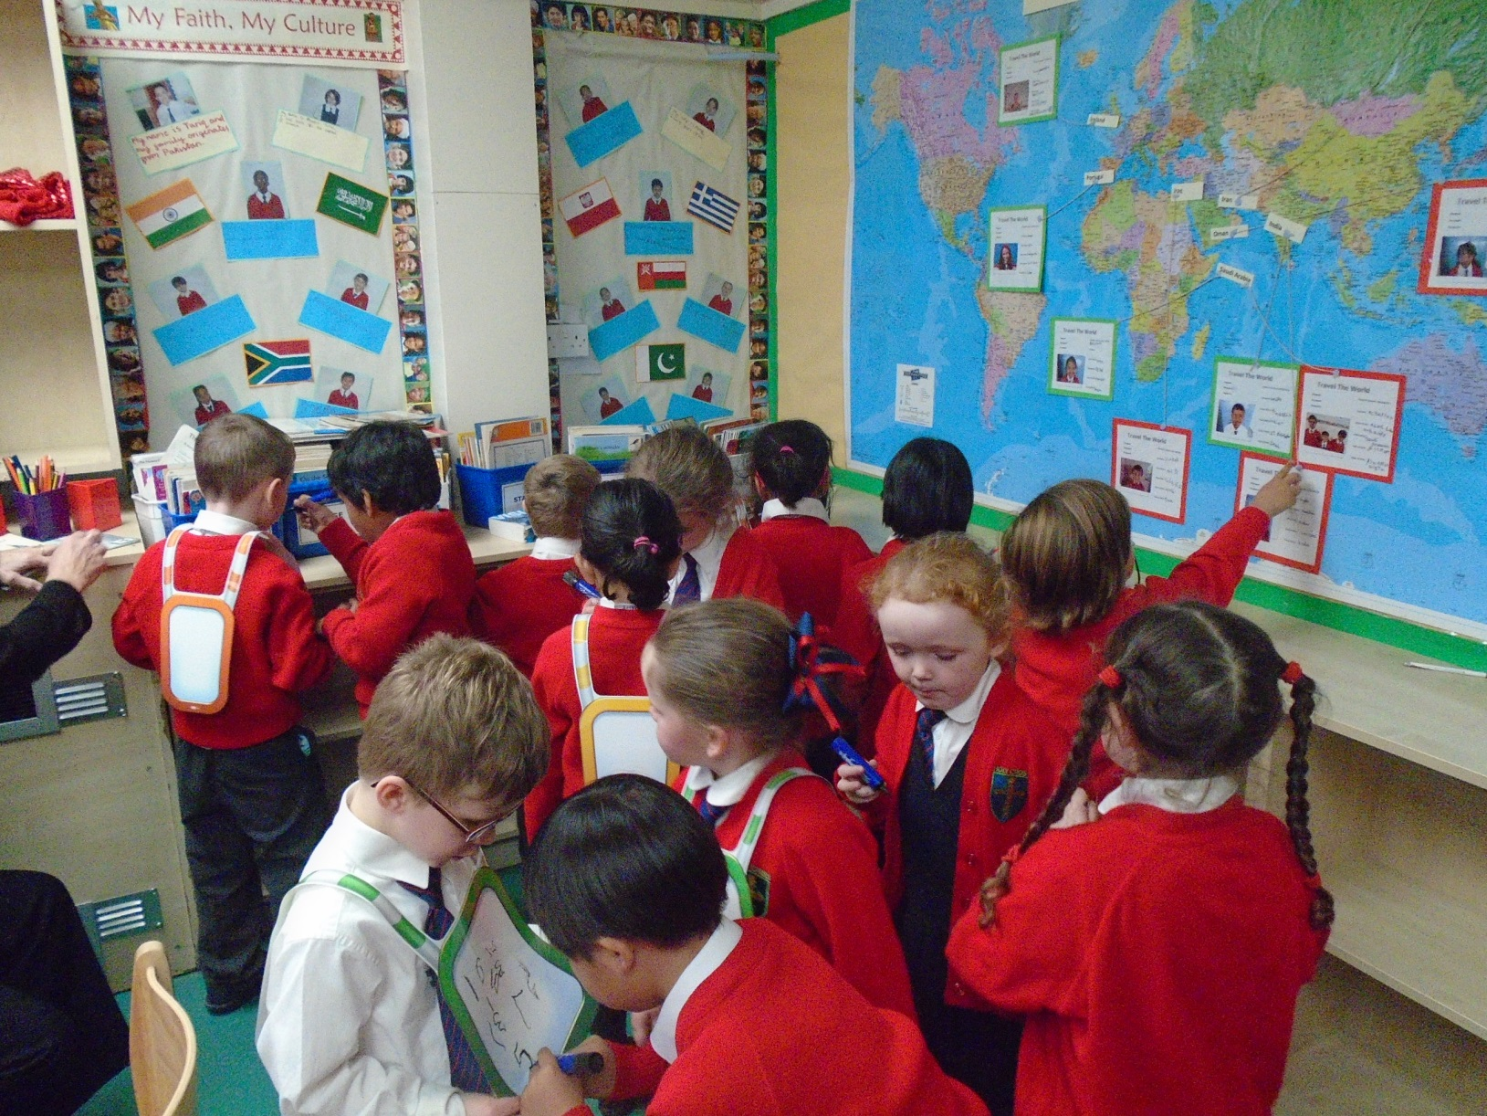
Finding numbers in the environment

Slide 5
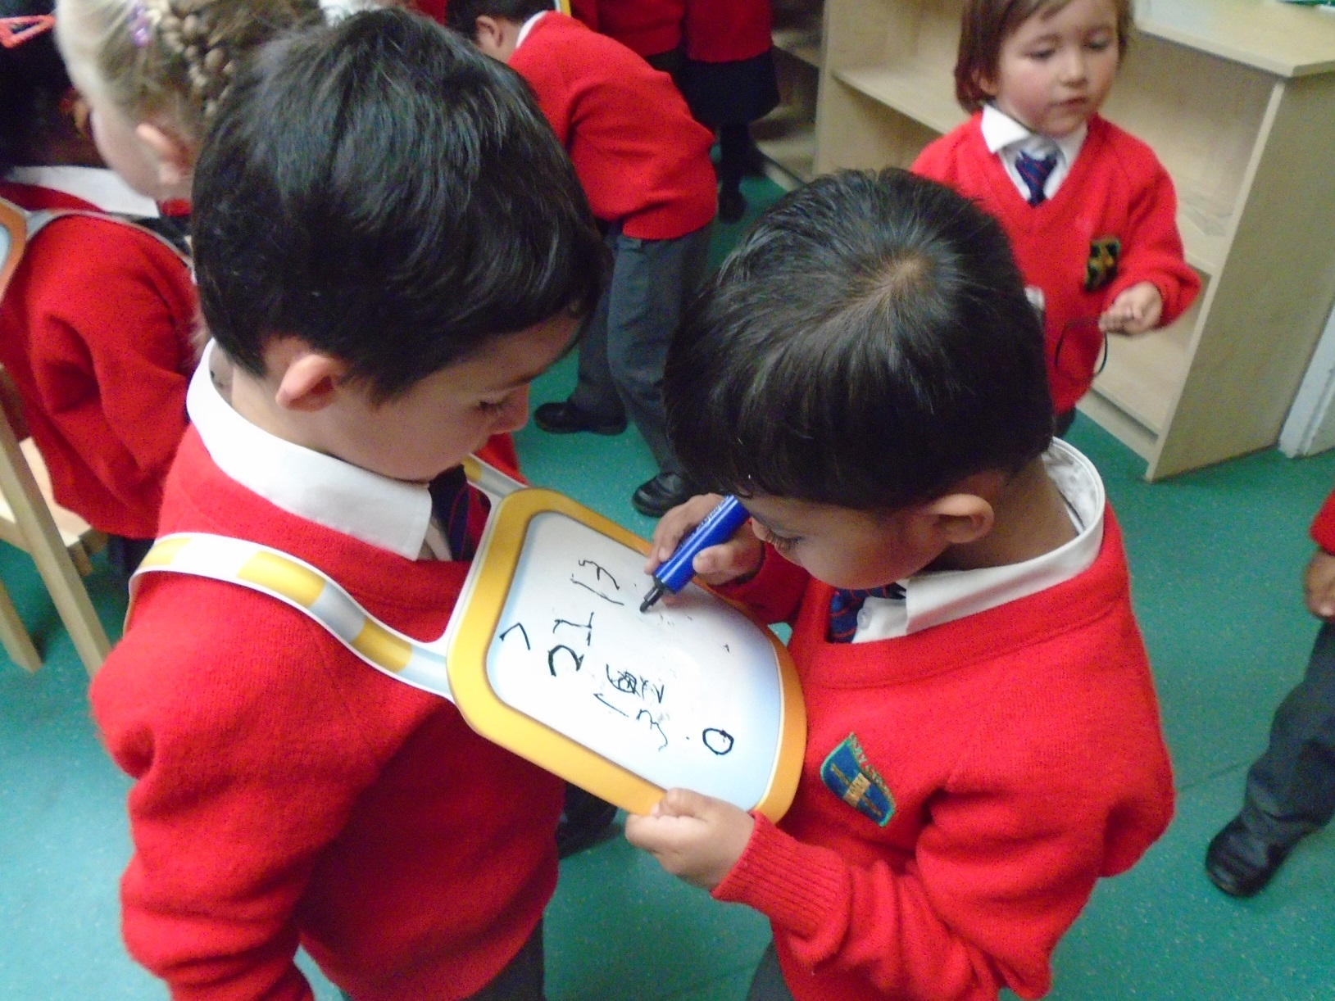
Mark making, writing and forming
numbers.

Slide 6
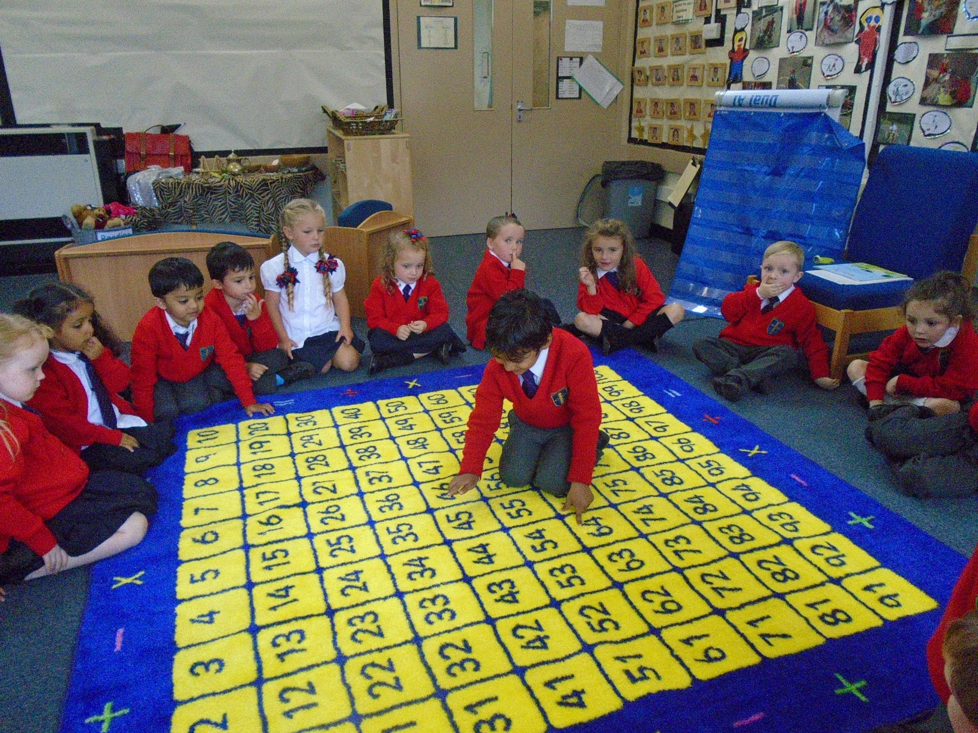
100 Square counting and games.

Slide 7
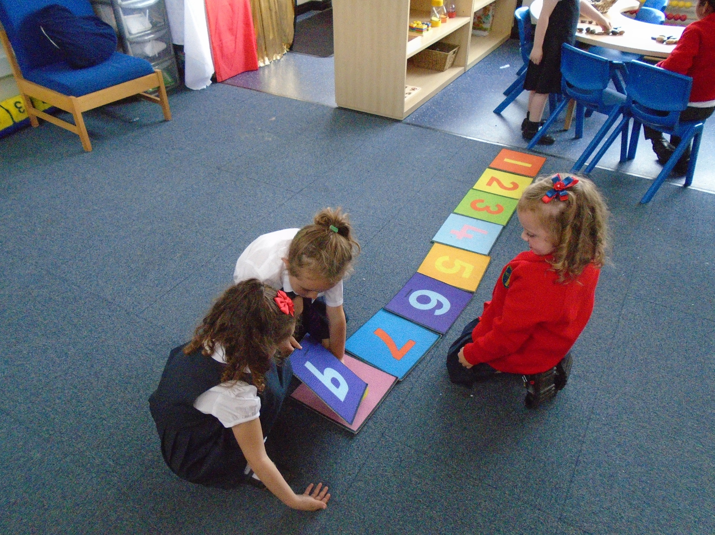
Ordering numbers independently.

Slide 8
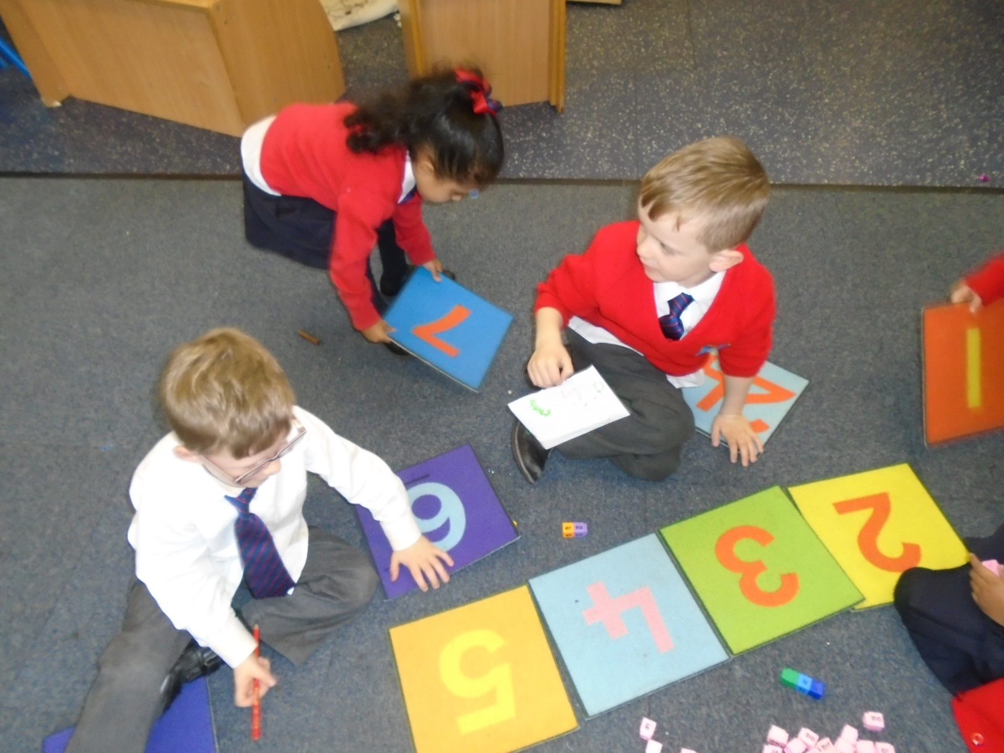
Working together to
match numeral to quantity.

Slide 9
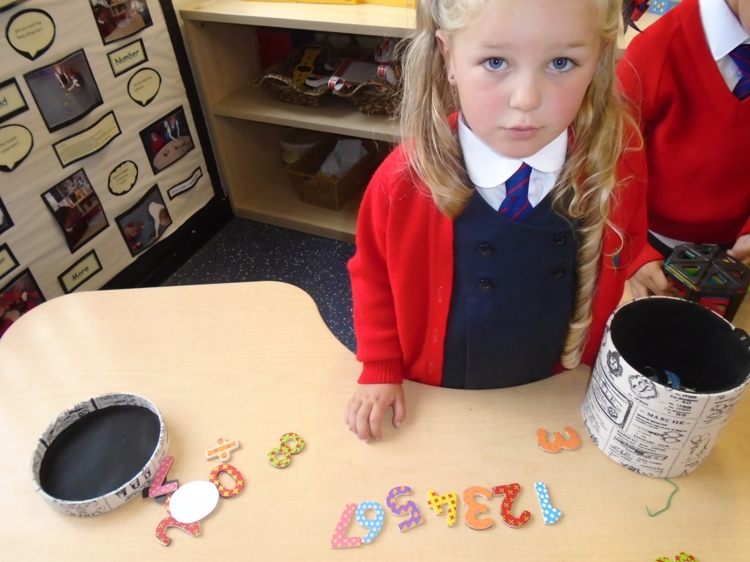
Ordering numbers…

Slide 10
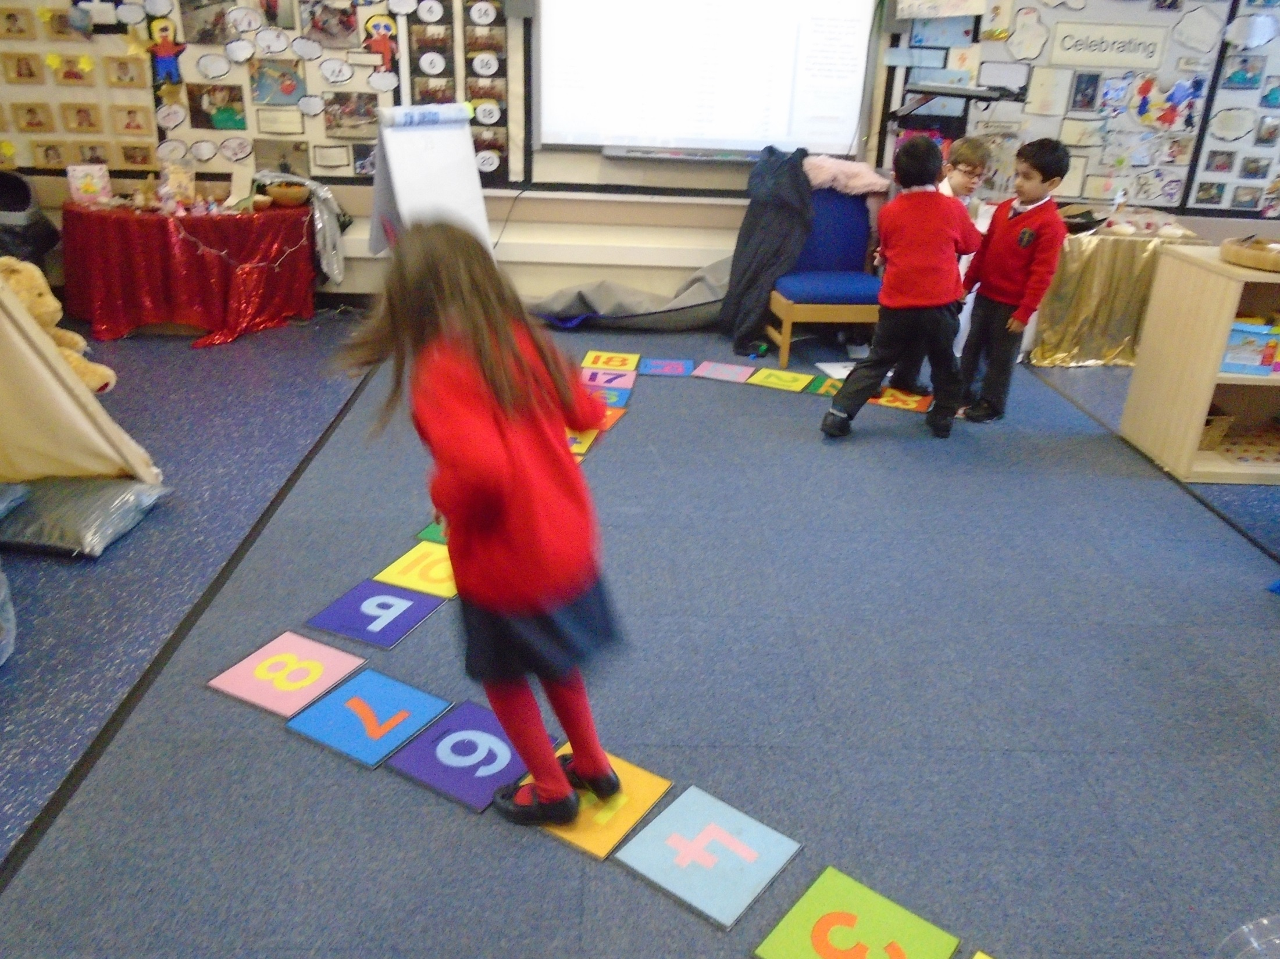
Playing games.

Slide 11
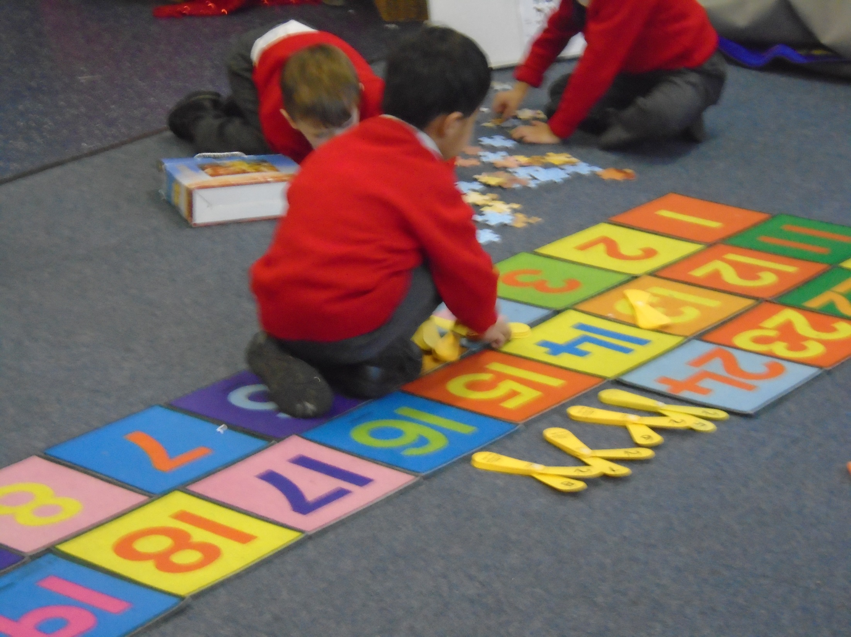
Solving Problems…

Slide 12
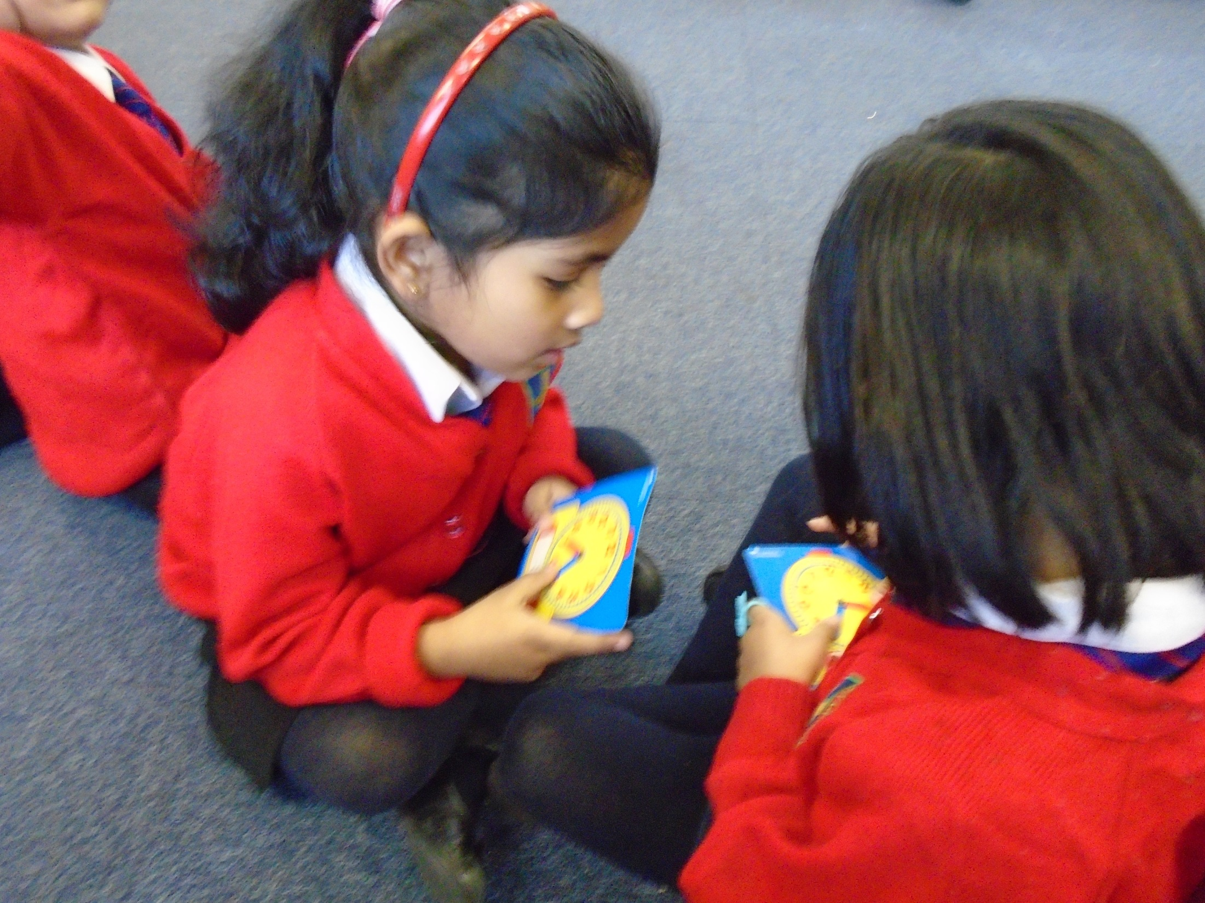
Understanding our daily routine

Slide 13
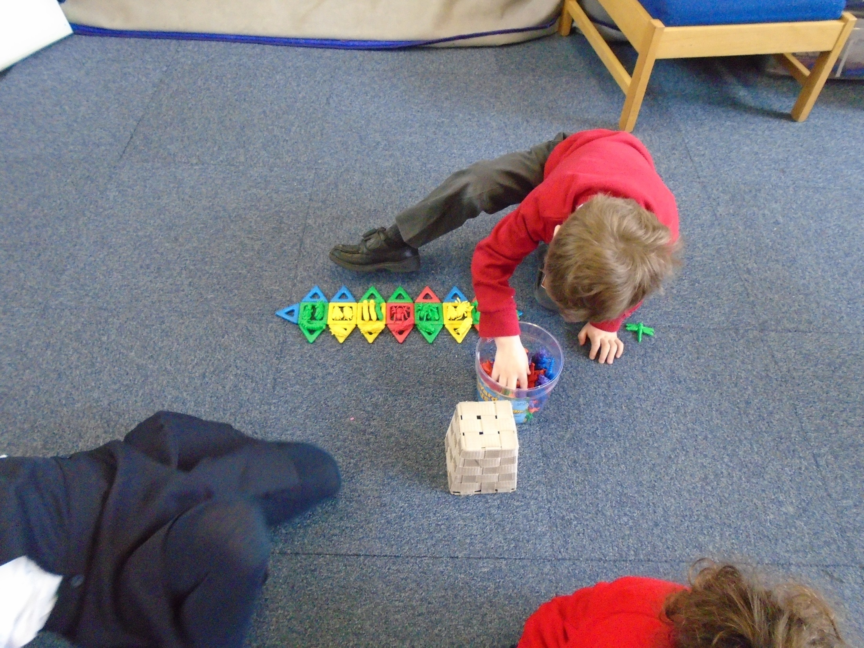
Sorting and grouping

Slide 14
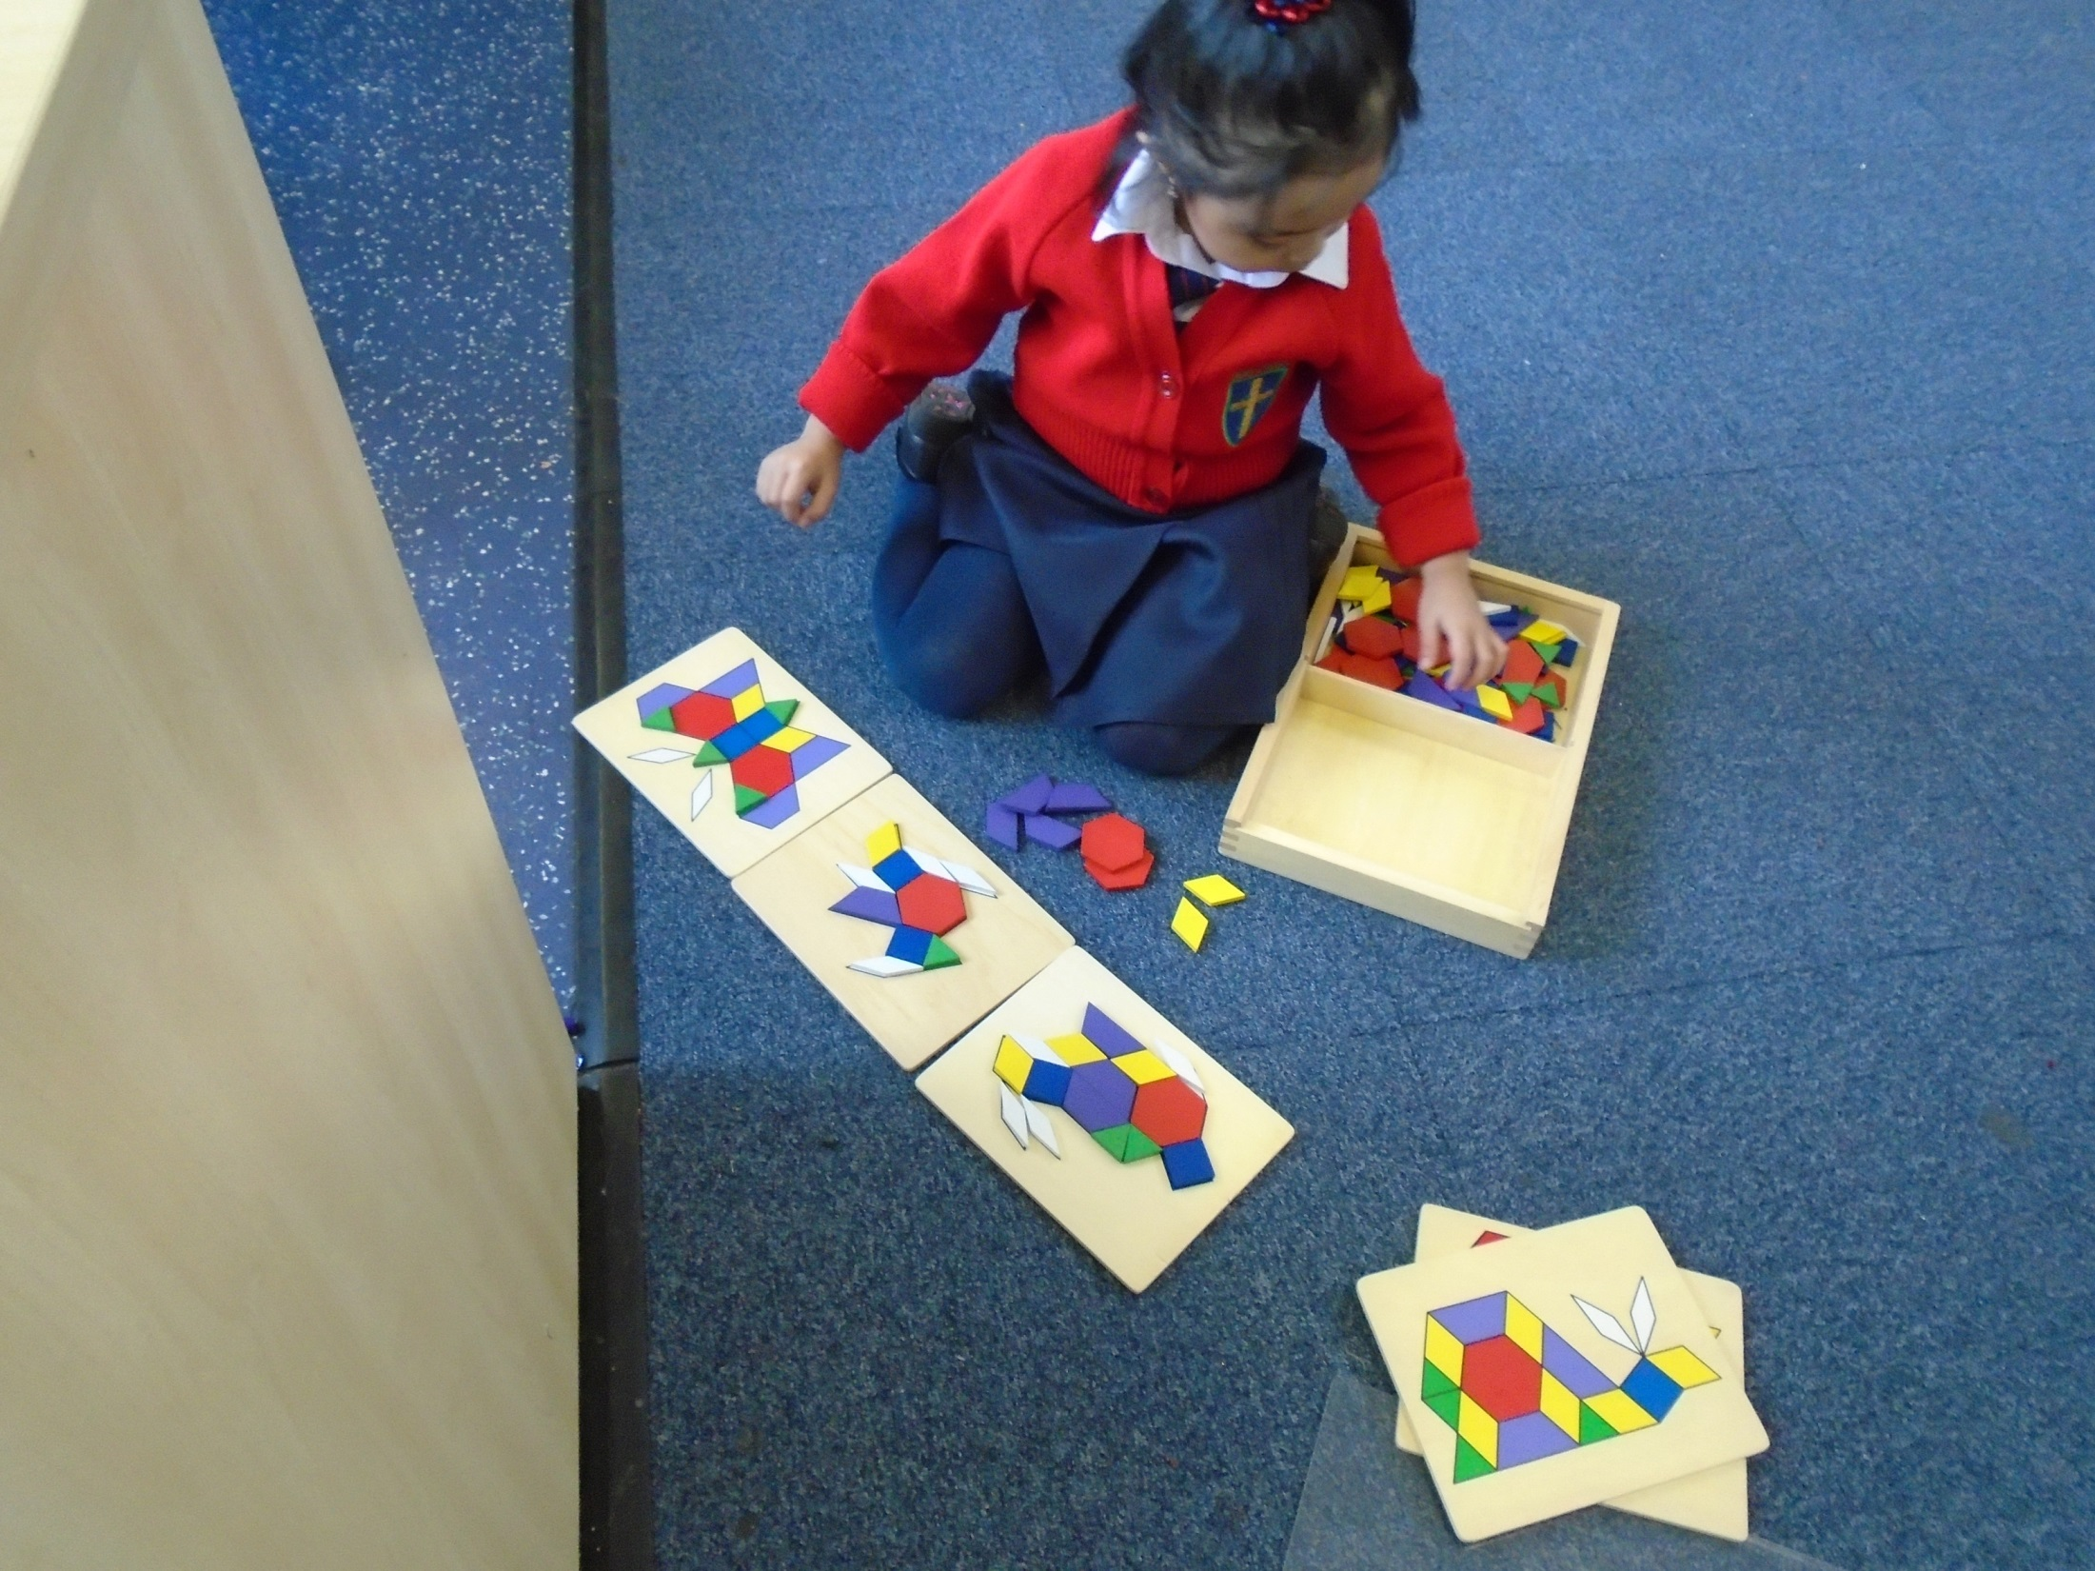
Following patterns.

