Slide 1

Aims
Explain how we teach calculation across the Early Years (EYFS) and Key Stage 1 (KS1).
Illustrate progression and development of skills used in each year group.
Explore resources and strategies used in the classroom.
Share with you some ideas of how you can help your child with their Math's at home.

Slide 2
Mathematics in Early Years
Math's in the Early Years, builds an important foundation for number work and problem solving in Key Stage 1.
Two aspects pf Early Mathematics in EYFS;
Numbers – early learning goal
Children count reliably with numbers from one to 20, place them in order and say which number is one more or one less than a given number. Using quantities and objects, they add and subtract two single-digit numbers and count on or back to find the answer. They solve problems, including doubling, halving and sharing.
Shape, space and measure –early learning goal
Children use everyday language to talk about size, weight, capacity, position, distance, time and money to compare quantities and objects and to solve problems. They recognise, create and describe patterns. They explore characteristics of everyday objects and shapes and use mathematical language to describe them.

Slide 3
Maths through play and practical experiences
Before we can embark on any kind of formal calculating there are vital practical processes the children need to experience.
Role play- shops, maths market, cookery.
Construction- Building to develop shape and space.
Outdoor play- sand, water, games, coins
Rhymes and songs
Stories
Games

Slide 4
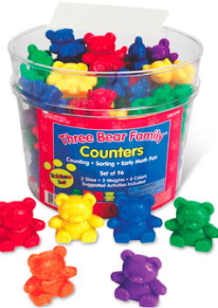
Calculating
Say numbers in order
Recognize numerals
Develop problem solving skills
Identify more and less
Begin to relate addition to combining two groups of objects and subtraction to ‘taking away’

Slide 5

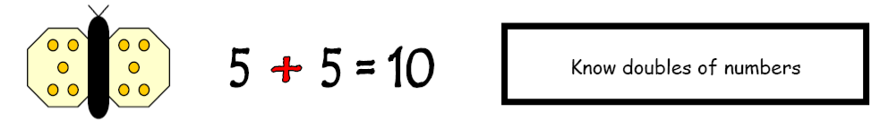
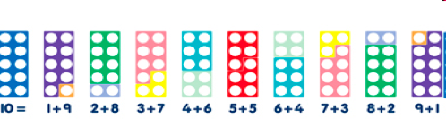
Calculation Strategies
Find pairs of numbers that total 10.

Slide 6

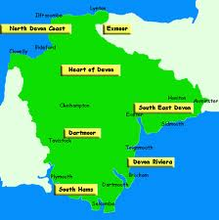
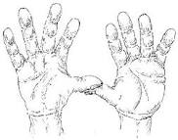


Number bonds to 10
0 to 10 are big strong men
1 and 9 are feeling fine
2 and 8 are never late
3 and 7 come from Devon
4 and 6 like to play tricks
5 and 5 come alive
6 and 4 hold open the door
7 and 3 visit for tea
8 and 2 are feeling blue
9 and 1 have just gone
10 and 0 are super heroes!!!!!!!

Slide 7
Shape and Space
Use mathematical language – greater, heavier, longer, smaller, under, beside
Identify patterns
Identify and describe shape
Recognize and name coins and learn to use them in practical experiences

Slide 8
How is learning achieved in Early Years?
Through structured play, adult led activities and child initiated learning.
Using counting rhymes, stories and games.
We encourage the use of counting different resources, gems, shells, compare bears, fingers, number fans, numicon and number lines up to 10 and 20, 100 squares.
We talk about 1 more/ 1 less, odd and even and multiples of 2 and 10 up to 20, doubles and halves.
Early addition and subtraction.

Slide 9
How YOU Can Help...
Repeat it and repeat it!
•Build it into everyday life E.g.: shopping, counting carrots into the saucepan etc…
Do little and often.
Praise.
Play lots of games.
Remember that math's should be FUN!

Slide 10
Daily routine ideas….
  Bath-time (filling and emptying containers, counting)
  Counting rhymes
  Talk about numbers in the environment (e.g., front door numbers, number plates, road signs etc.)
  Help with the cooking (measuring, weighing, ordering the recipe)
  Setting table places (how many plates/cups etc.)
  Paying in shops (including change)
  Estimating amounts (how many apples/sweets?)

Slide 11
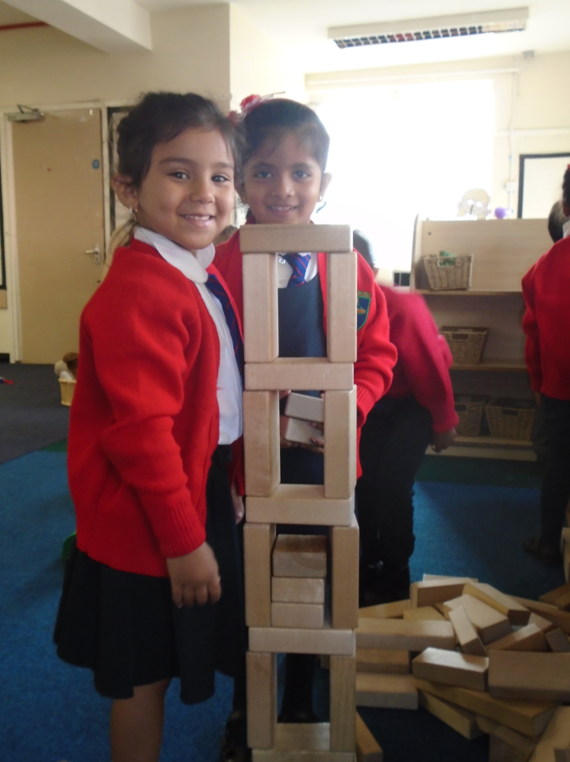
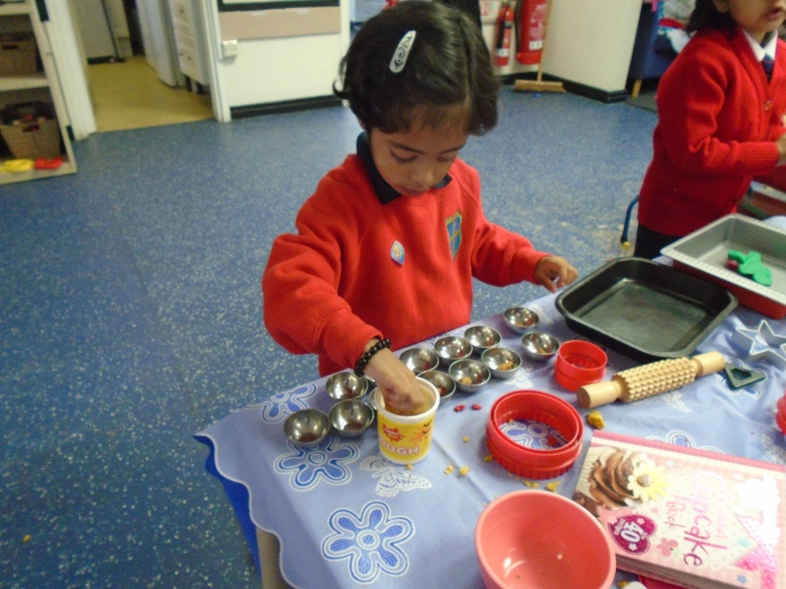
This is how we learn!
Meaningful, purposeful, engaging, real, repetition,
lots of language and
vocabulary and lots and lots of play!

Slide 12
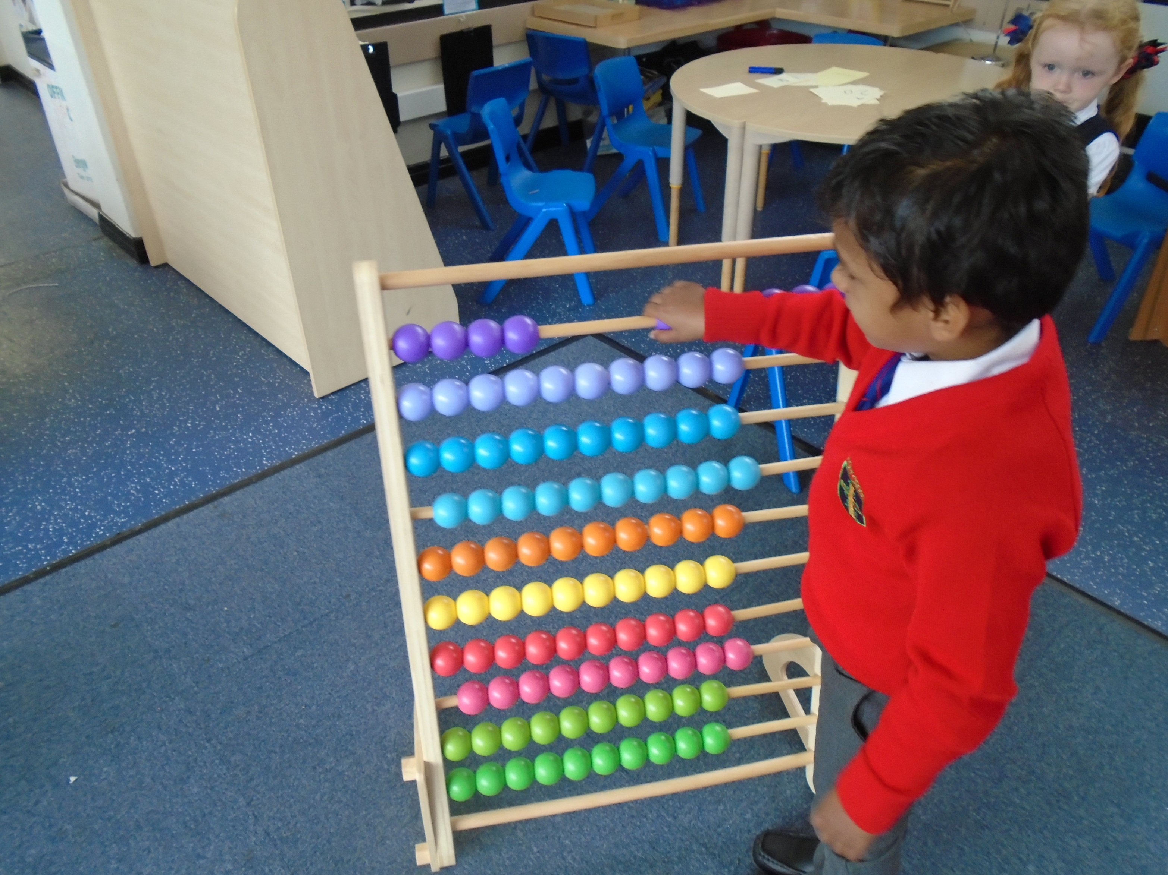
Counting forwards and backwards,
In ones, twos and tens.

