Slide 1
1
3
2
Maths for All
Holy Cross Catholic Primary School
Thursday 12th February 2015:Reception/ KS1
Friday13th February 2015: KS2

Slide 2
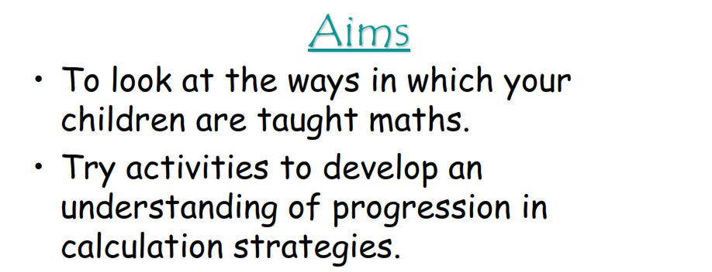
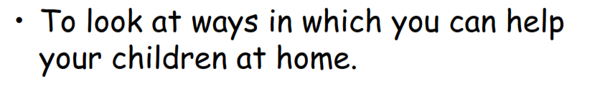

Slide 3
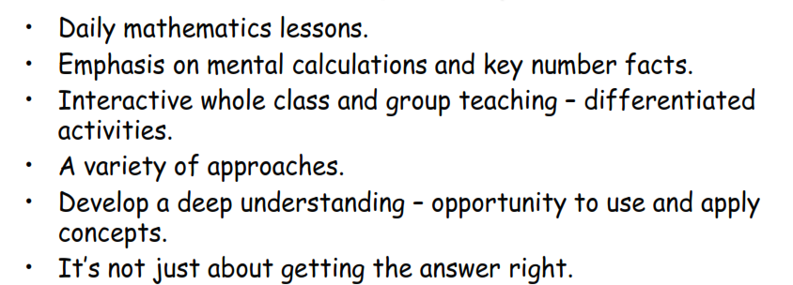
Resources used: Abacus, Numicom, number lines, number square, counters, place value counters.

Slide 4
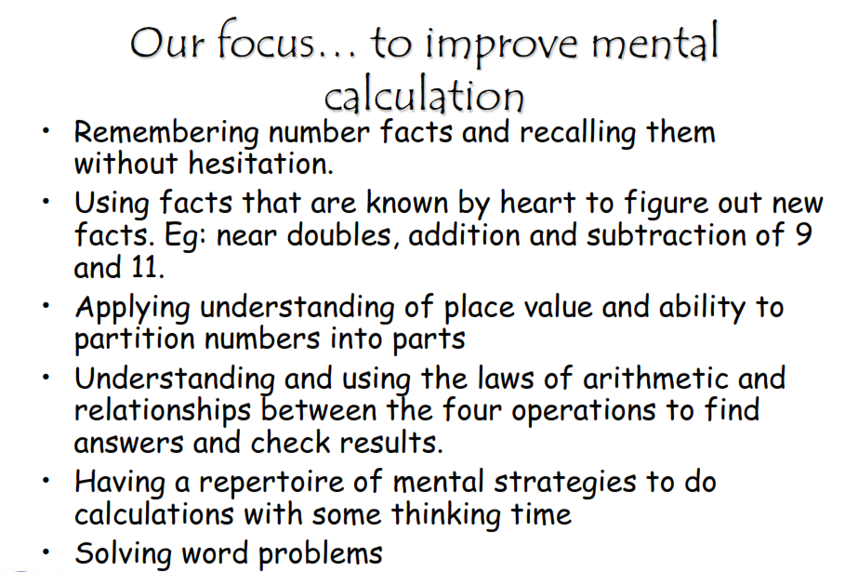

Slide 5
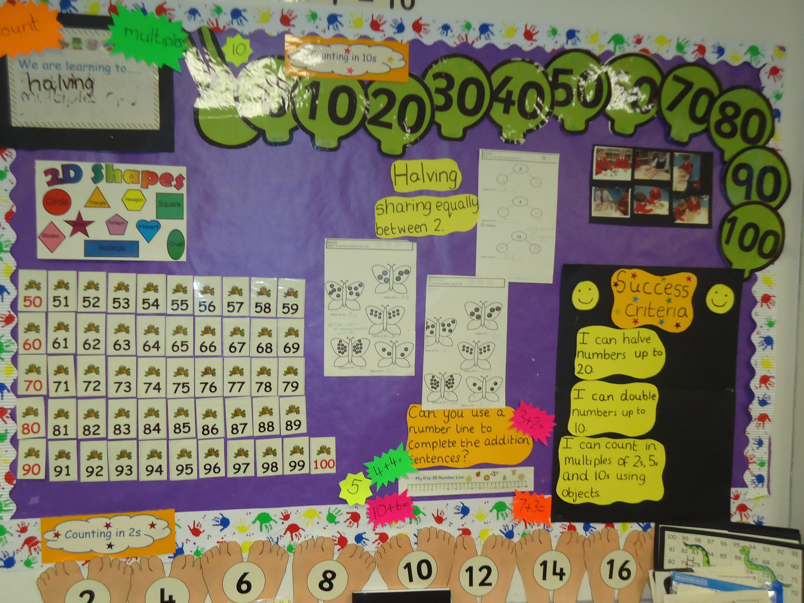

Slide 6
Year One
By the end of Year One all children should be able to confidently:
Count on and back in ones to and from 100 and from any single-digit or 2-digit number.
Count on and back in tens from any 1-digit or 2-digit number, e.g. 23, 33, 43, 53... Continue to just over 100.
Locate any number on a 1-100 grid or a beaded line 0-100.
Know number bonds to 10, e.g. 5 + 5, 6 + 4, etc. Also know what is left if objects are taken from 10, e.g. 10 fingers, fold down 4, leaves 6 standing.
Begin to be aware of unit patterns, e.g.
2 + 4 = 6 7 + 4 = 11
12 + 4 = 16 17 + 4 = 21
22 + 4 = 26 etc. 27 + 4 = 31 etc.
Recognise the + and – and = signs, and use these to read and write simple additions and subtractions.
Add small numbers by counting on and subtract small numbers by counting back
Recognise doubles to double 6 and find related halves (half even numbers ≤12).
Recognise the difference between 2-D and 3-D shapes; identify and describe common 2-D and 3-D shapes.
Recognise and compare objects according to height or length, weight or capacity, using appropriate mathematical language. E.g. the tree is taller than the bush, the bag is heavier than the shoes, the teapot holds more than the jug.
Tell the time to the half hour on analogue and digital clocks.
Sort items into lists or tables.

Slide 7
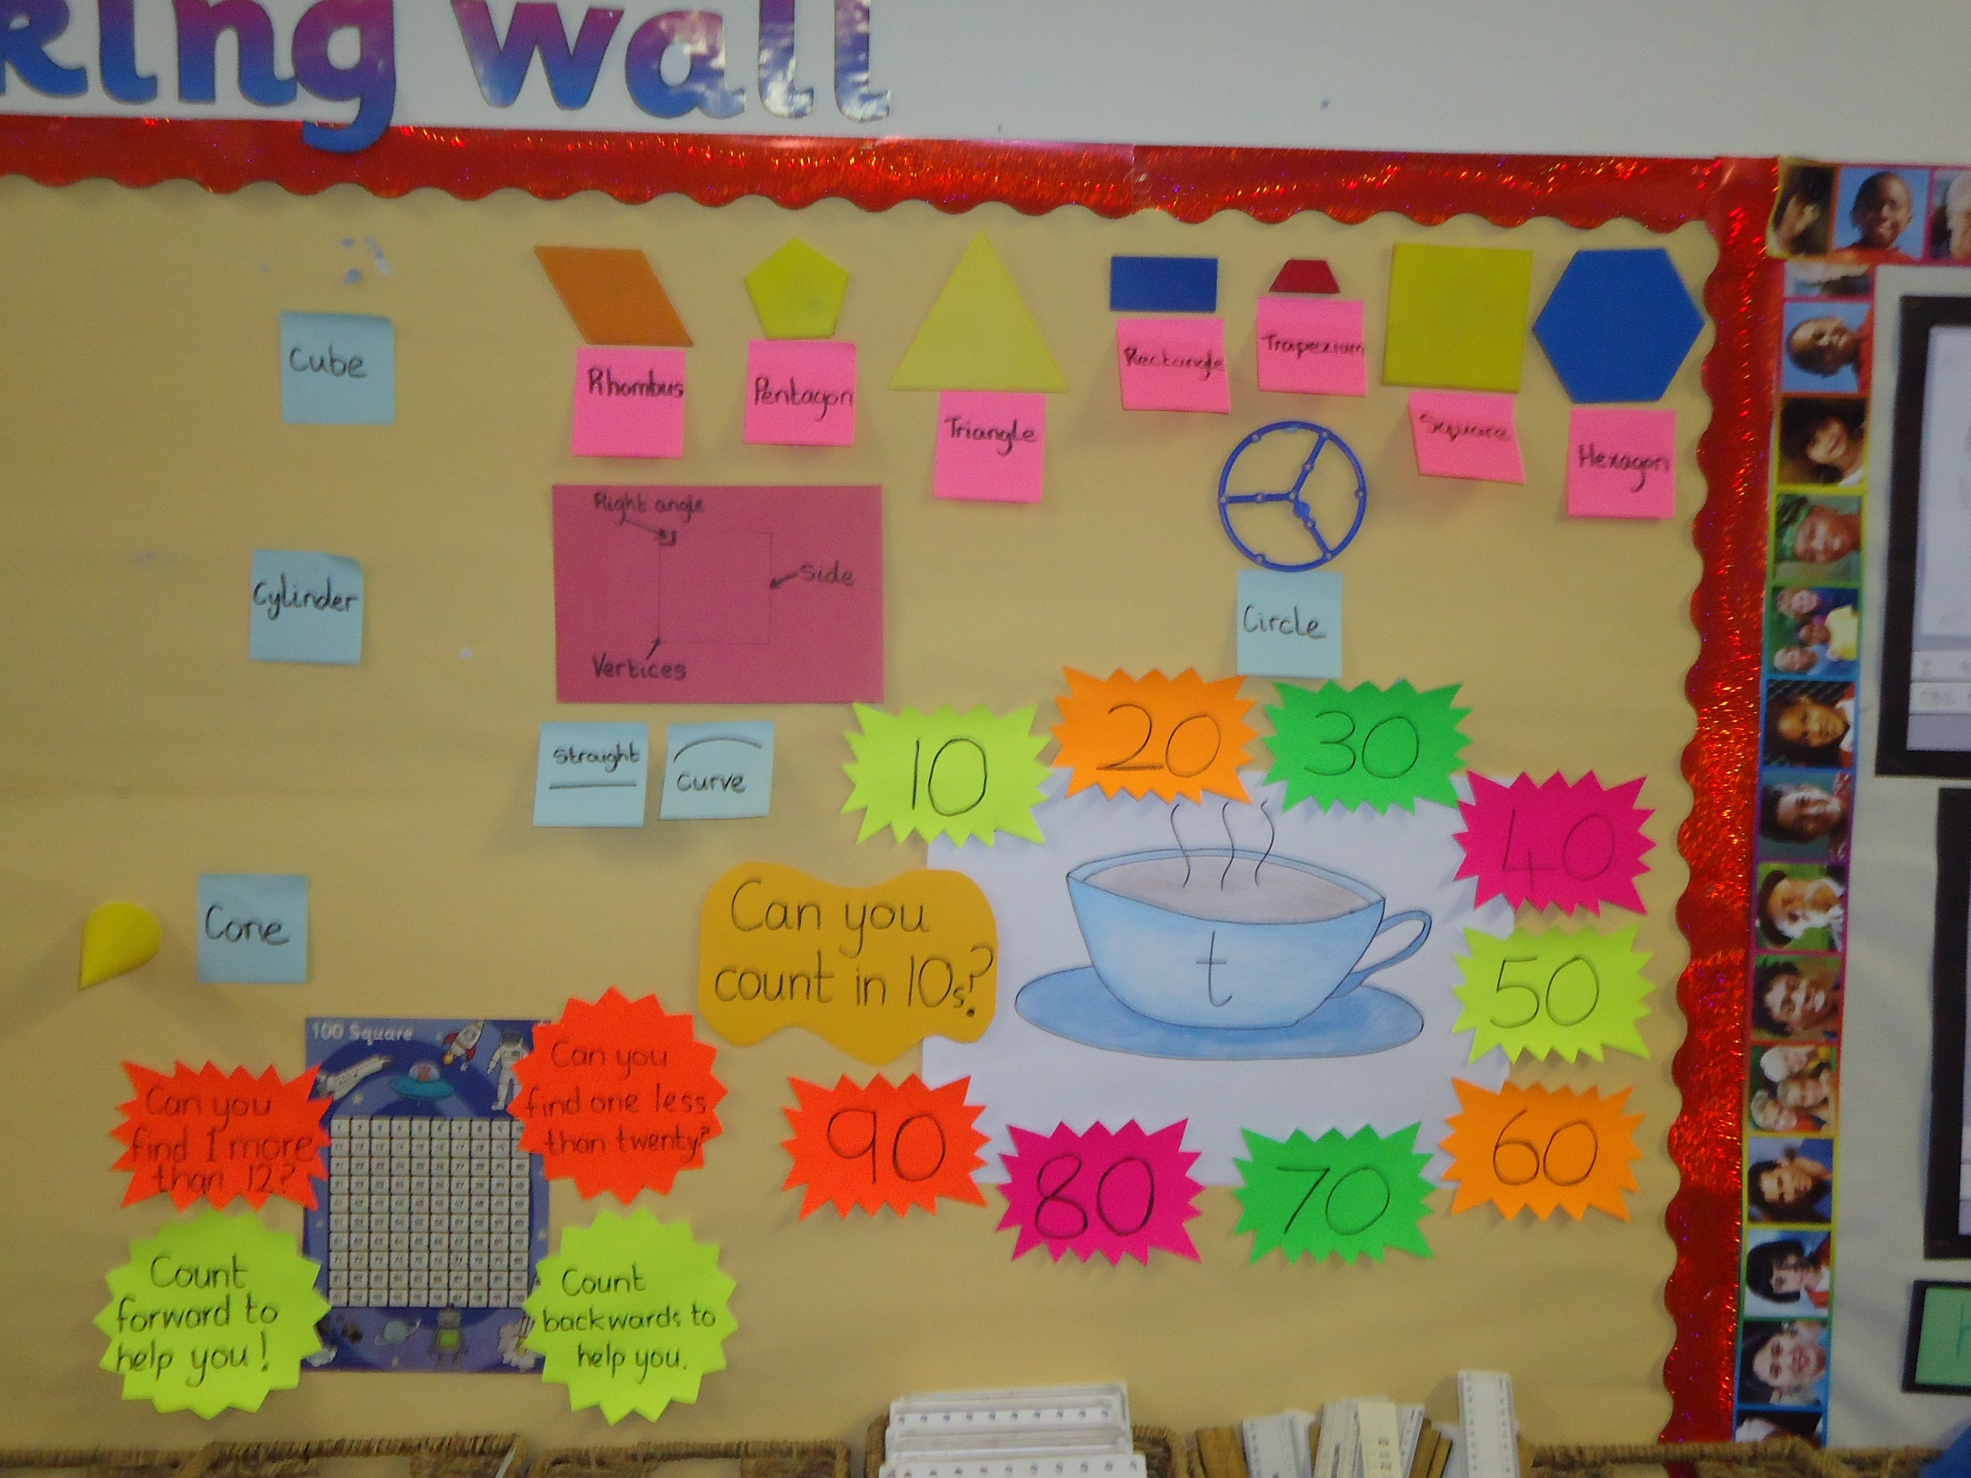

Slide 8
By the end of year two children should be able to confidently:
Locate any 2-digit number on a landmarked line and use this to compare numbers; record comparisons using crocodile signs, e.g. 56 > 39.
Identify any number on the 1-100 number grid; understand that each number is a multiple of ten and some ones, e.g. 54 is 50 and 4 more.
Know securely number pairs for all the numbers up to and including 12, e.g. pairs which make 8 (4+4, 5+3, 6+2, 7+1, 8+0) and bonds to 10 (1+9, 2+8, 3+7, 4+6, 5+5).
.Recognise that addition and subtraction are inverse operations and understand that 10 – 4 = 6 as well as 6 + 4 = 10
Count in steps of 2, 5, and 10 from 0.
Count in halves e.g. ½, 1, 1½, 2, 2½, 3…
Know different unit patterns when not crossing a ten, e.g. 4 + 3 = 7
14 + 3 = 17
24 + 3 = 27, etc.
Begin to recognise unit patterns when crossing a ten, e.g. 5 + 6 = 11
15 + 6 = 21
25 + 6 = 31, etc.
Add two single digit numbers (8 + 7) by counting up; add two 2-digit numbers which total less than 100 by counting on in tens and ones, e.g. 54 + 37 as 54 + 30 + 7.
Count back in ones or tens to take away, e.g. 27 – 3 = or 54 – 20 =.
Begin to count up to find a difference between two numbers with a small gap (42 – 38).
Know the 2X, 5X and 10X tables and begin to say how many 10s are in 40 or how many 5s are in 30; use X sign correctly and begin to use ÷ sign.
Understand the concept of one half, one quarter and three quarters as numbers (½, ¼, ¾) and as operators (½ of 6 is...?) in a practical context, e.g. on a fraction strip or with smarties on a cake.
Compare and order objects according to their lengths, weights and capacities using suitable units.
Identify and describe, with reference to relevant properties, 4 or more common 2-D and 3-D shapes.
Tell the time on digital and analogue clocks to the nearest quarter of an hour.

Slide 9
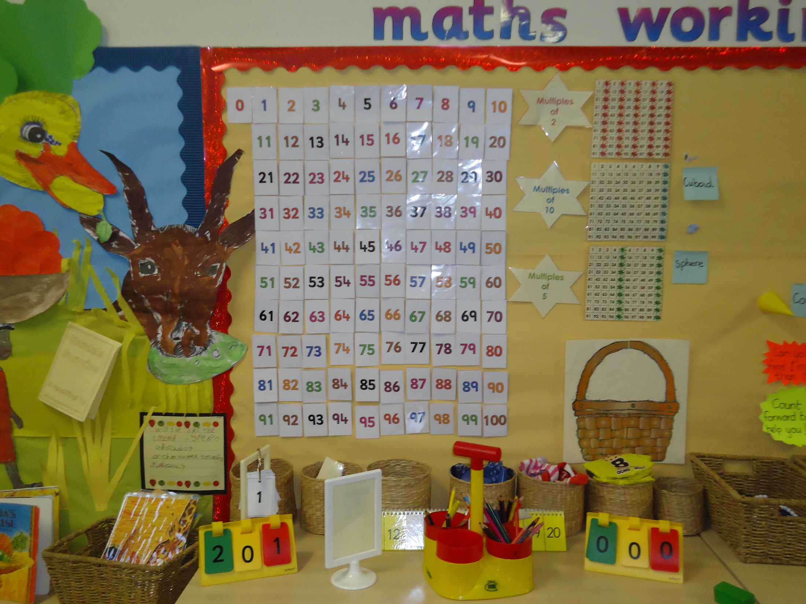

Slide 10
Number Fun Songs

Slide 11
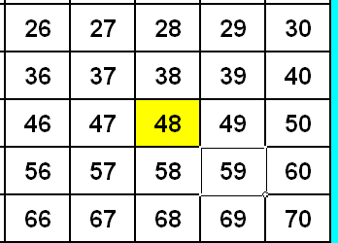
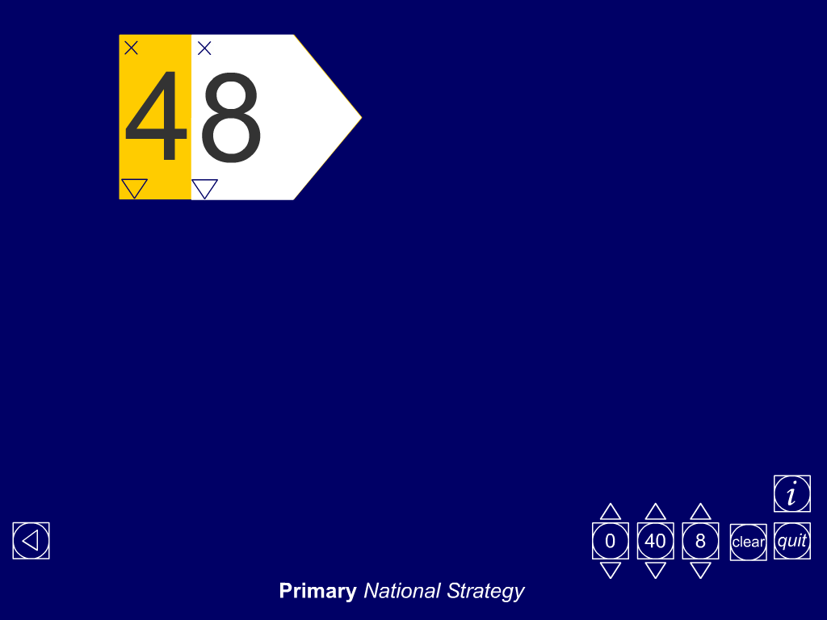
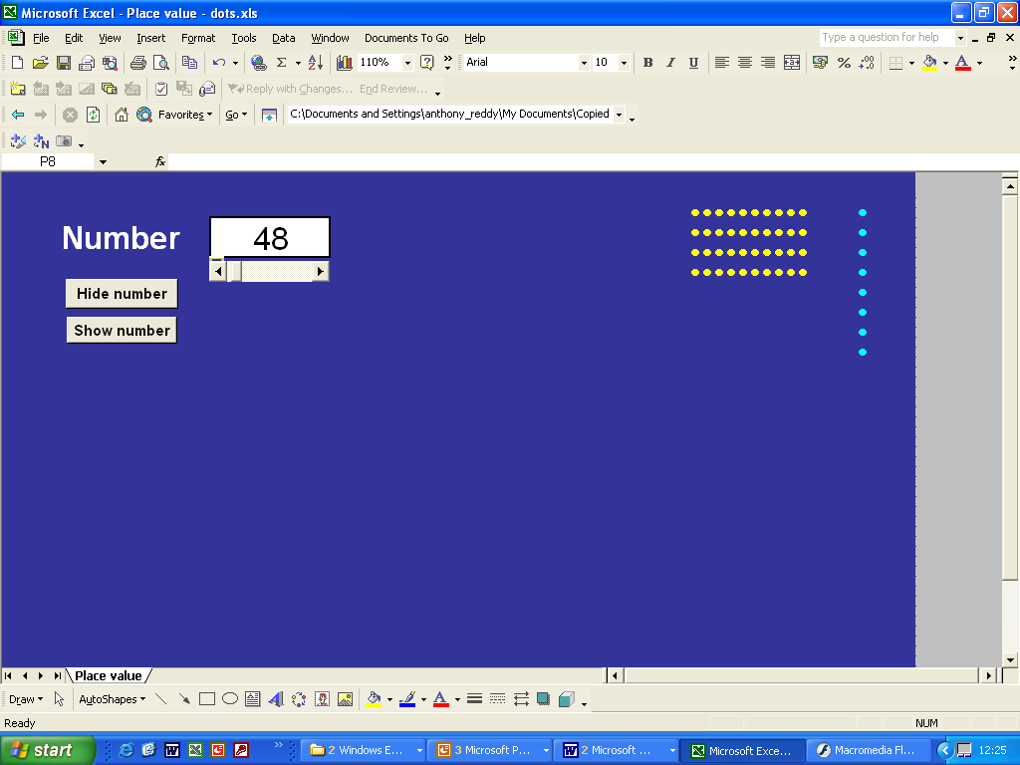
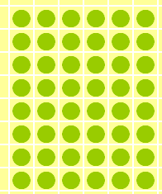
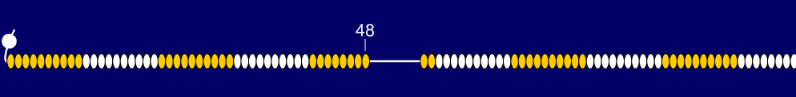
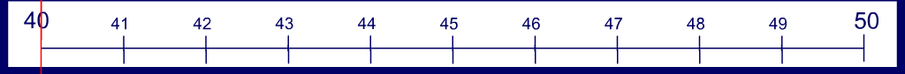
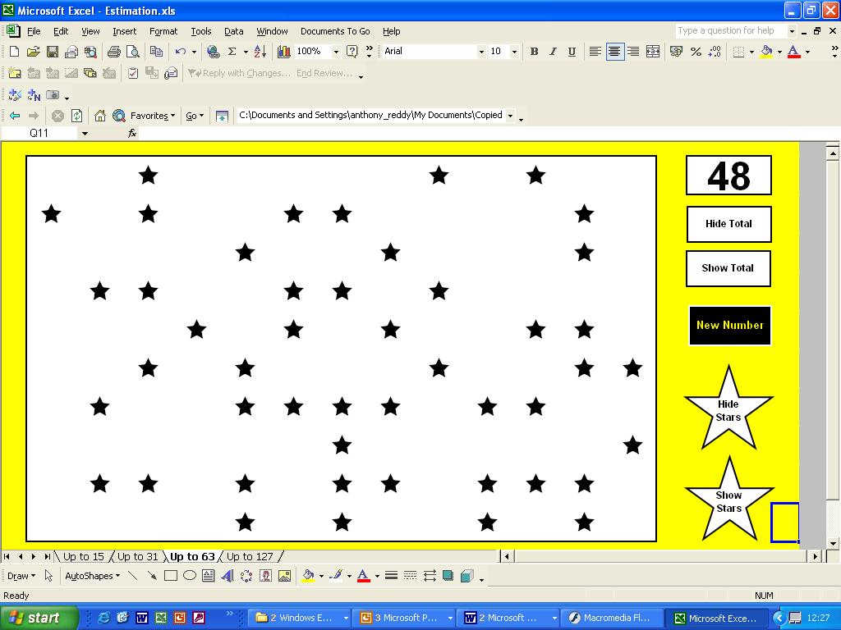
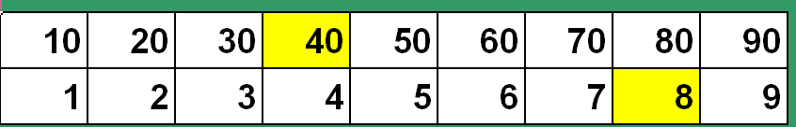
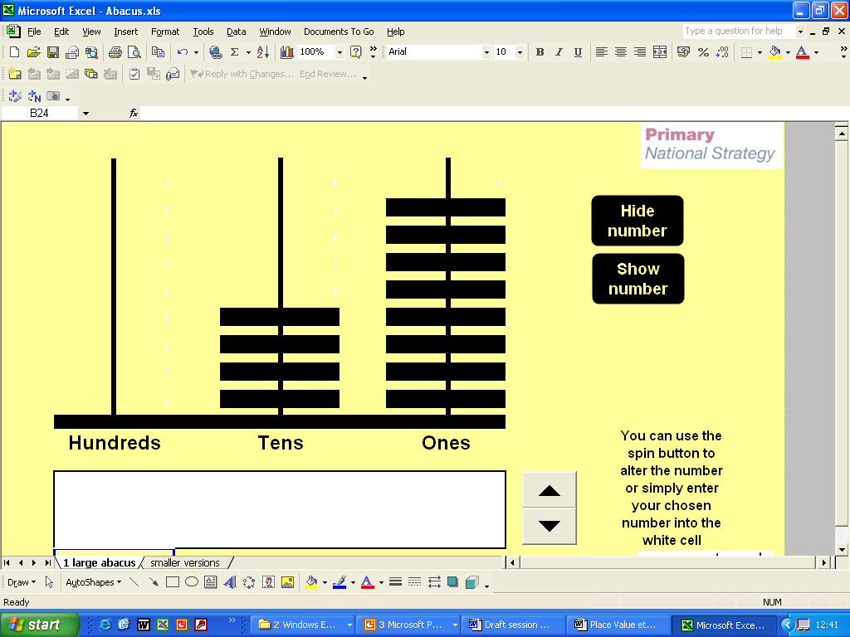
48
40 + 8
30 + 18
Forty eight
Four tens and eight units
10
10
10
10
5
1
1
1

Slide 12
Decisive Dice Digits - RULES
The aim of the game is to get as near to 100 as possible following five rolls of the dice, which is controlled by the teacher.
To begin with, play as a whole class and make a group decision on where to place each digit in the grid (see below).
When the children are used to the game they can play individually or in pairs.
The dice is rolled, and the players must decide whether to place the digit in the 1’s or 10’s column.
The dice is rolled a total of five times, and after each roll the digit is placed in one of the columns. A running total should be kept after each roll.
Following five rolls, work out the grand total. The player who is nearest to 100, either under or over, is the winner.

Slide 13
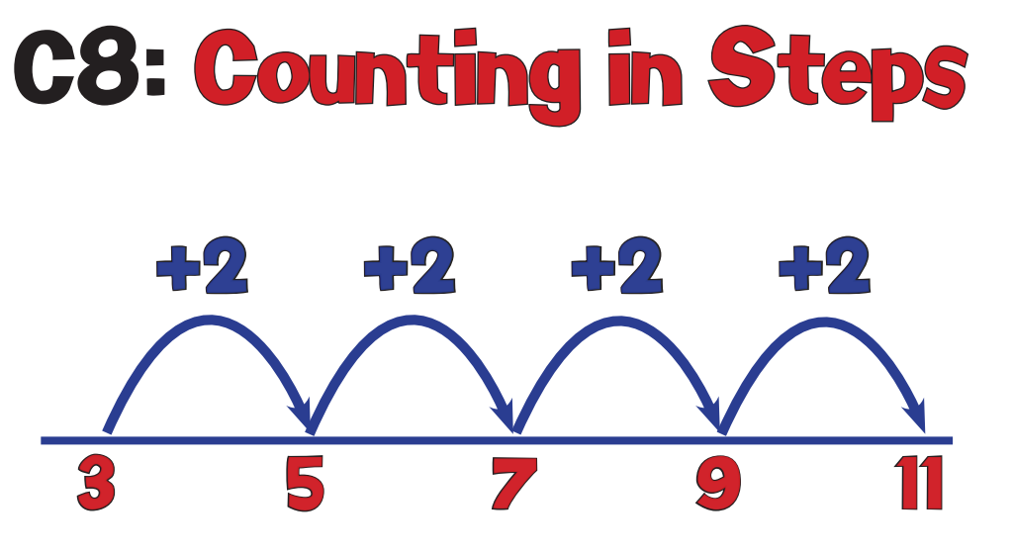

Slide 14
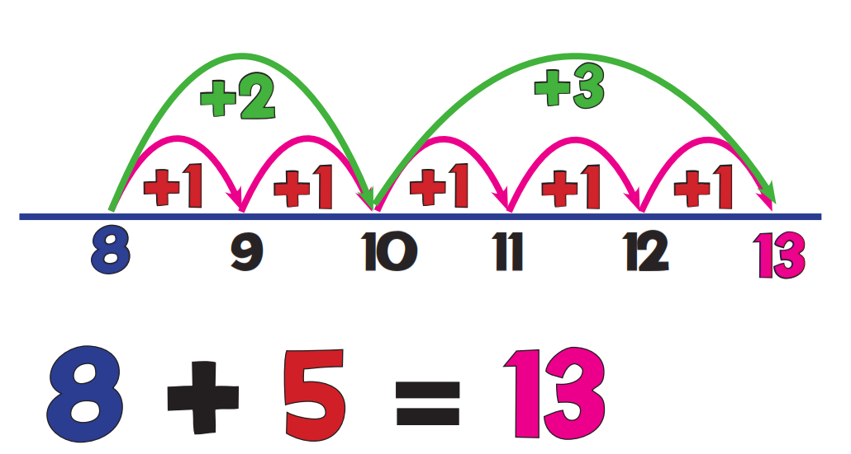

Slide 16
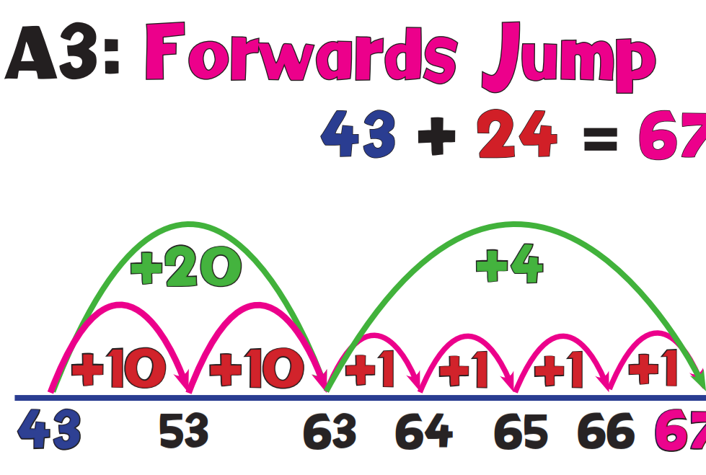

Slide 17
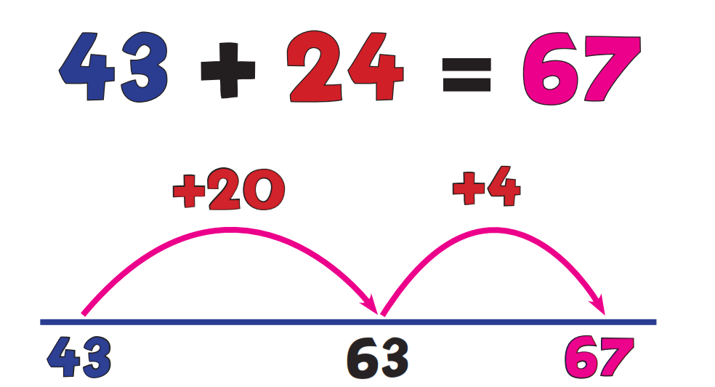

Slide 18
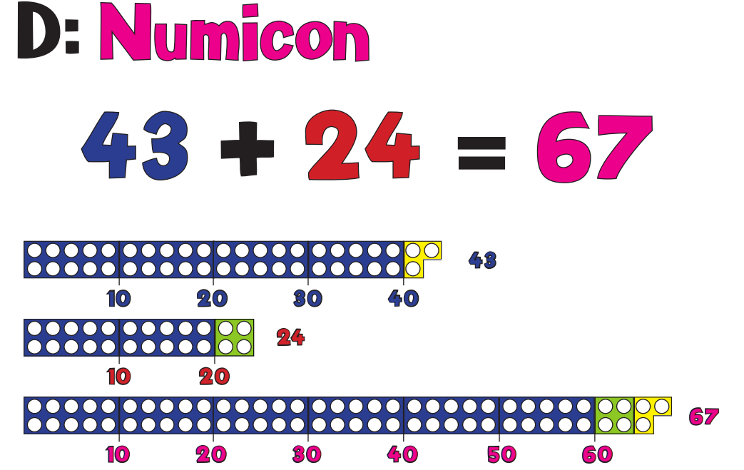

Slide 19
42+ 17=
35+26=
57+33=

Slide 20
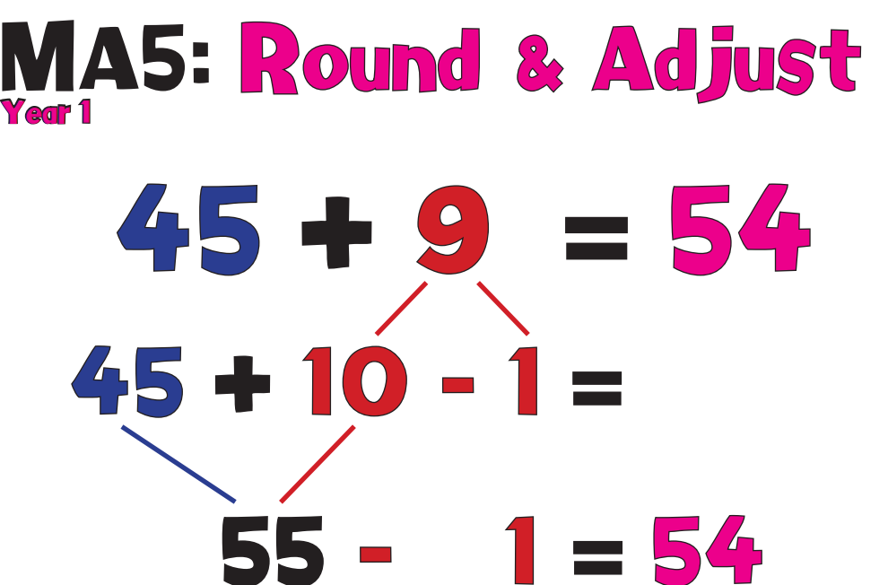

Slide 21
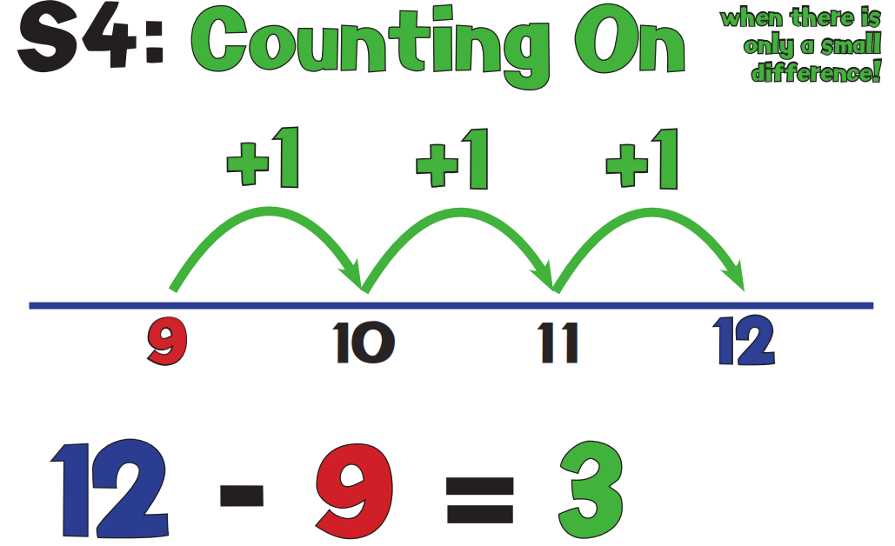

Slide 23
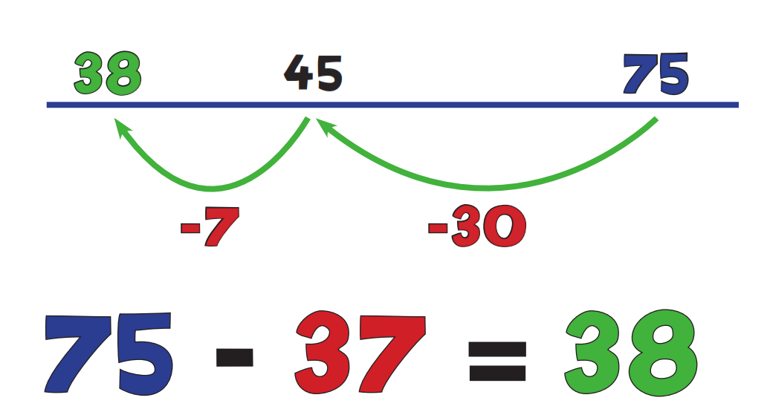

Slide 24
Use a number line to solve these
46-16=
58 – 24=
78 – 41=

Slide 25
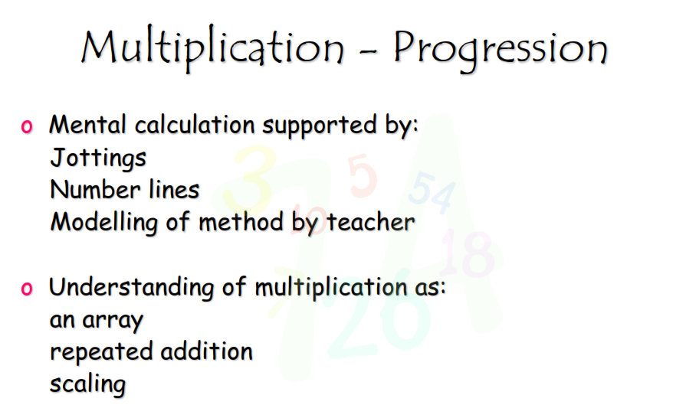

Slide 26
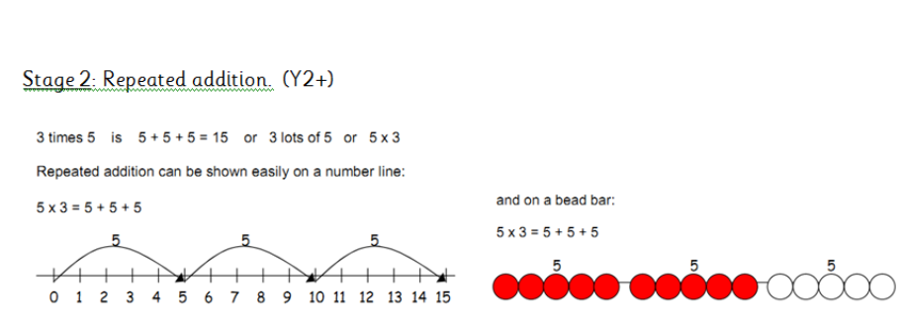

Slide 27
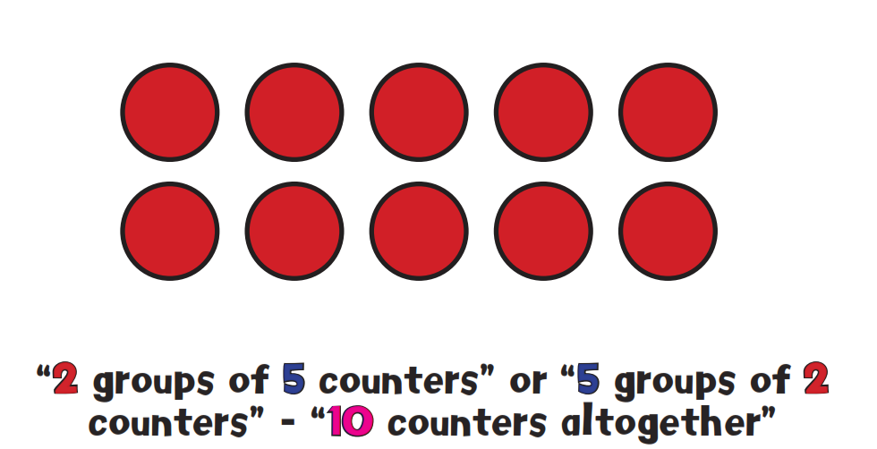
Pictorial Arrays

Slide 28
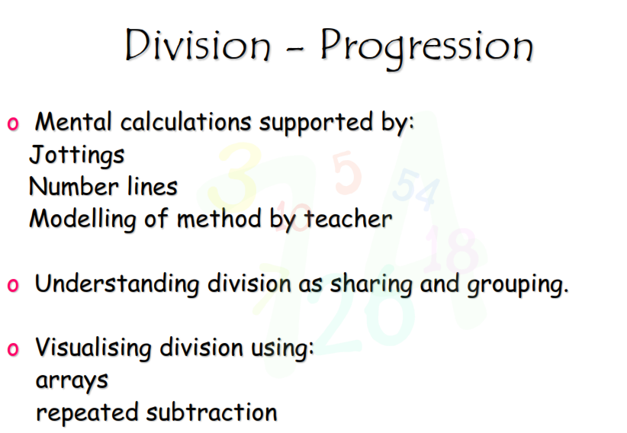

Slide 29
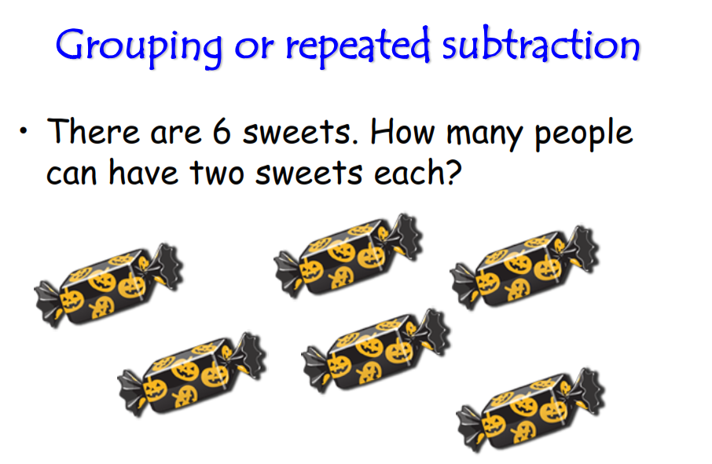

Slide 30
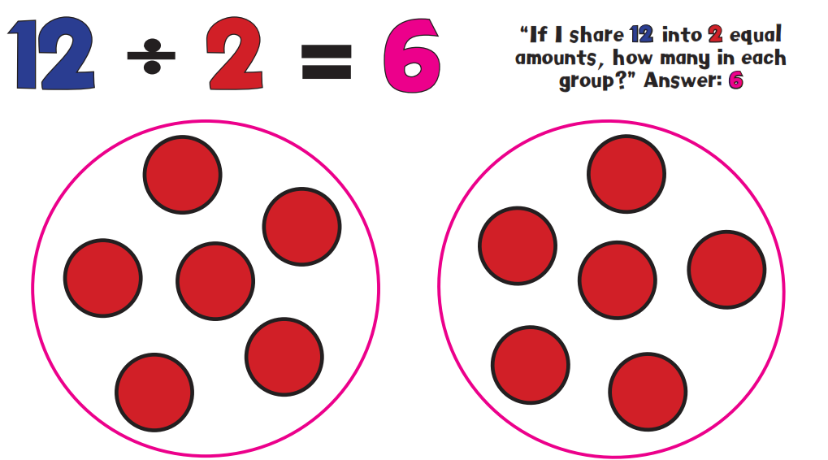

Slide 31
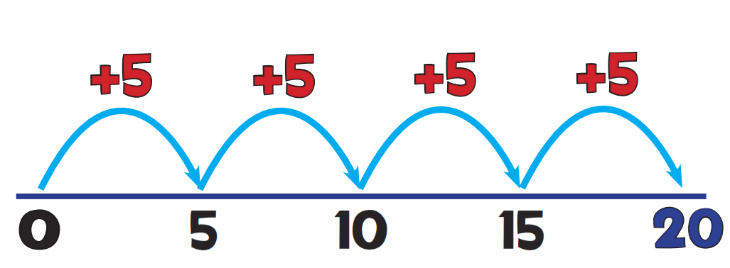

Slide 32
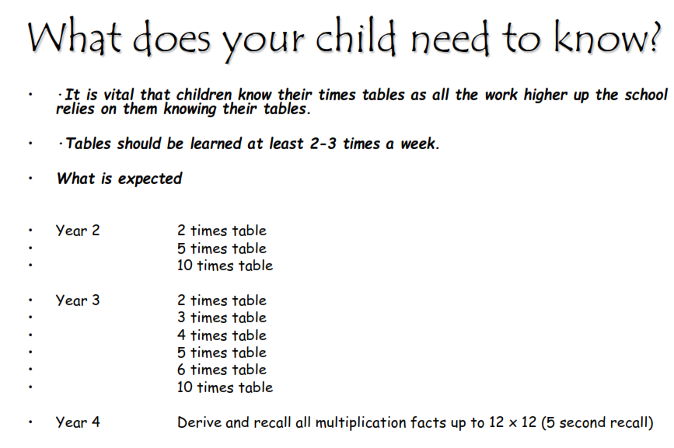

Slide 33
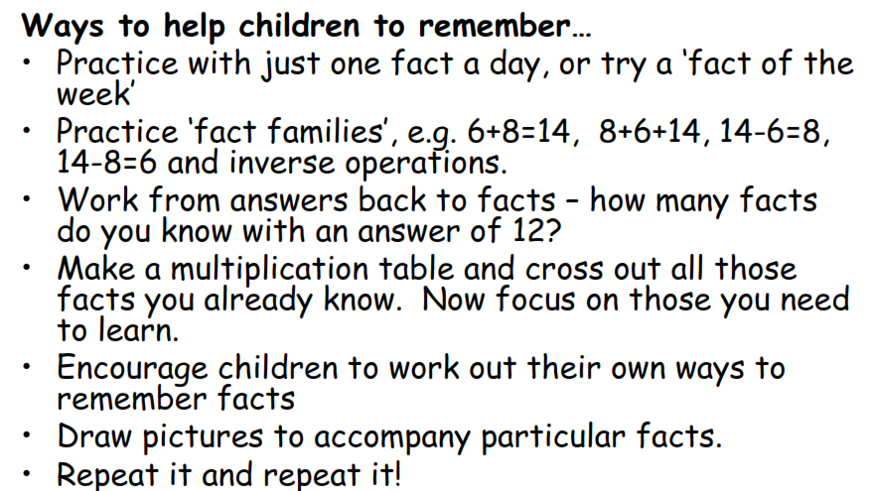

Slide 34
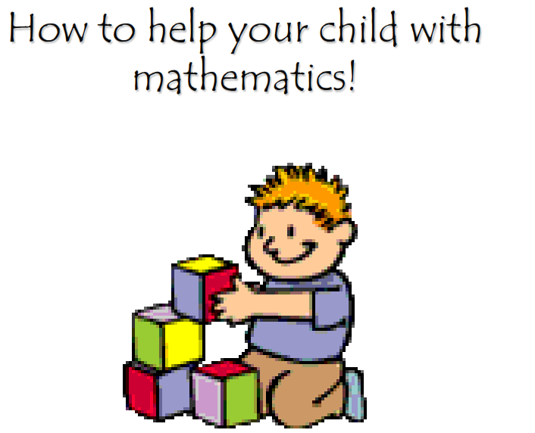

Slide 35
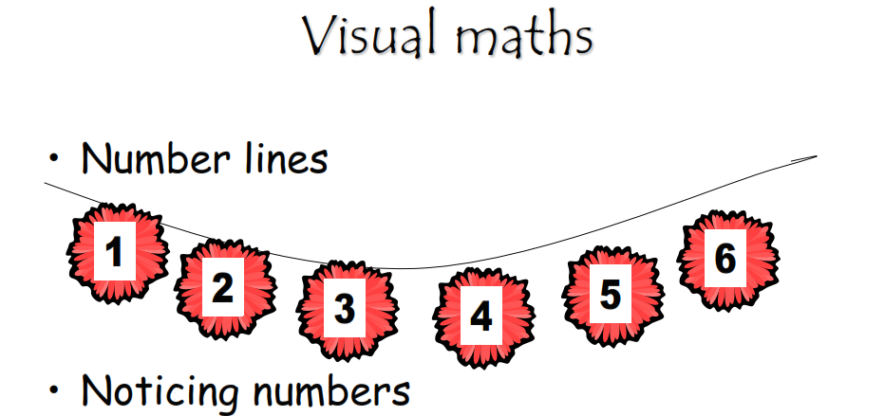

Slide 36
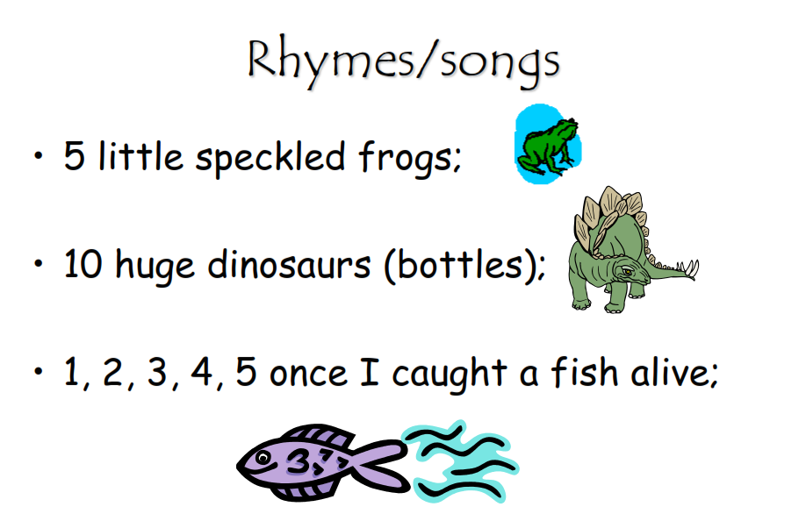

Slide 37
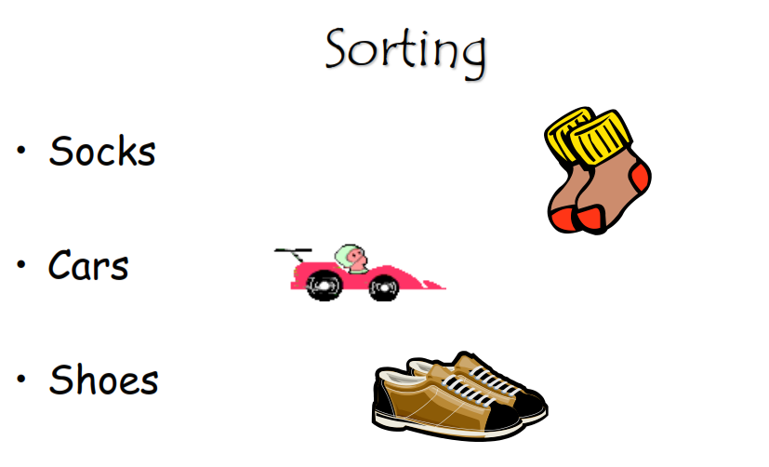

Slide 38
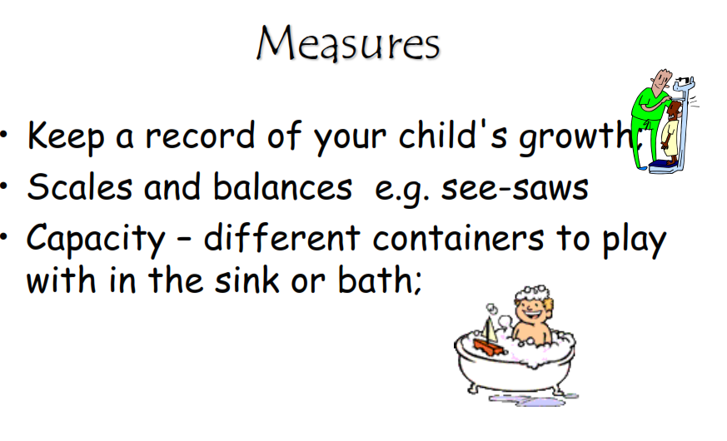

Slide 39
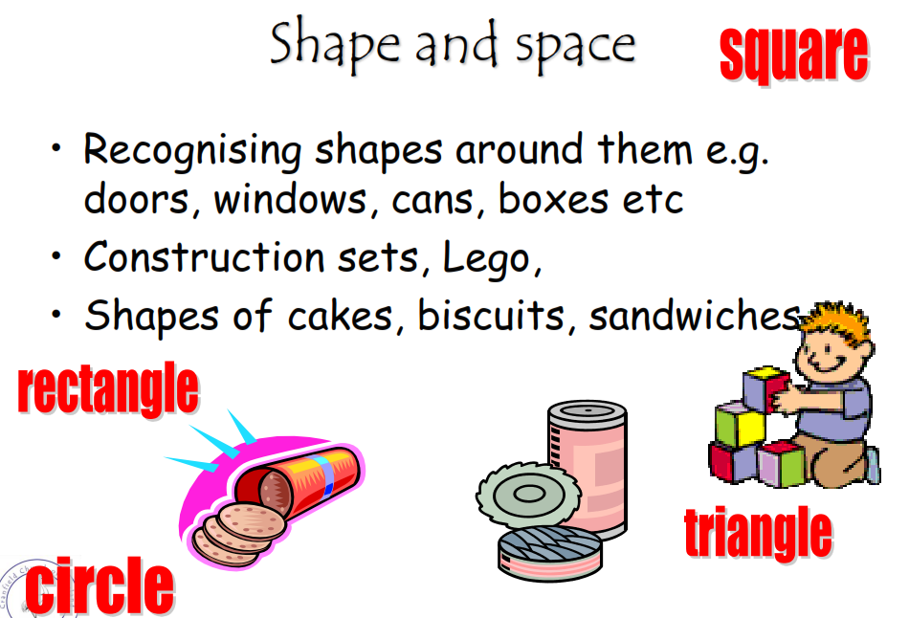

Slide 40
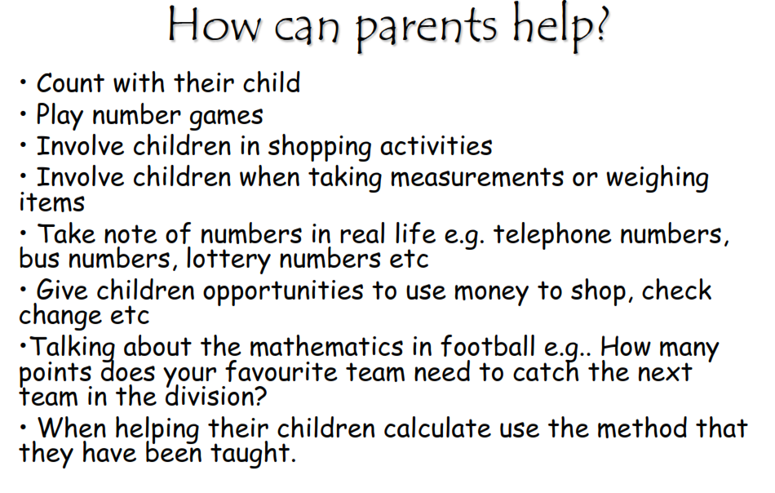

Slide 41
ICT:
Mathsletics
Purplemash
Maths is fun
Top Marks/ school website
Crickweb

Slide 42
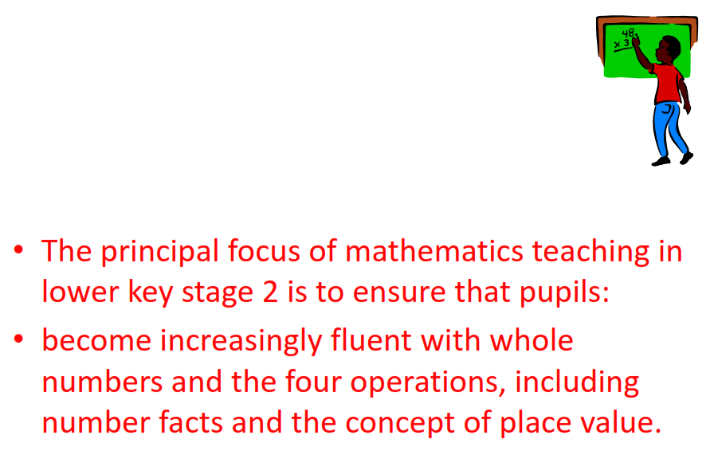
Keys
Key Stage 22

Slide 44
The New Curriculum
What ‘s new in KS2
Roman Numerals
Volume
Circle
Geometry
Statistics
Algerbra

Slide 45
Year 3
By the end of year 3 children should be able to confidently:
Locate any 3-digit number on a landmarked line from 0-1000 and use this to order and compare numbers.
Understand place value in 3-digit numbers; add and subtract 1s, 10s or 100s without difficulty;
use this to add and subtract multiples of 1, 10, 100 to/from 3-digit numbers.
Know securely number pairs for all the numbers up to and including 20, e.g.
pairs which make 15 (7+8, 6+9, 5+10, 4+11, 3+12, 2+13, 1+14, 0+15)
Round to the nearest ten and hundred, e.g. 34 to the nearest ten is 30, 276 to the nearest hundred is 300.
Mentally add or subtract any pair of 2 digit numbers, e.g. 75 + 58 or 75 – 58
Recognise that there are two ways of completing subtractions, either by counting up (using Frog) or by counting back, e.g. 54 – 27 (counting up)
54 – 21 (counting back)
NB. It is not entirely how close the numbers are that decides which strategy (counting up or counting back) is appropriate,
it is the difficulty of the calculation involved. So 64 – 40 may be best done by counting back, but 64 – 27 is best done by counting up.
Children need to be able to recognise whether they want to count back or count up using Frog. If in doubt, use Frog! Children make fewer errors!
Subtract larger numbers with confidence, using Frog for counting up, e.g. 302 – 288
Understand that multiplication is commutative, e.g. 4 x 8 is the same as 8 x 4.
Know the 2x, 3x, 5x and 10x times tables. All tables need to be learned to 12th multiple. Include division facts (important).
So we know how many 3s in 36, i.e. 36 ÷ 3 = 12, as well as knowing 12 x 3 = 36.
Multiply any 2-digit number by 10 or a single-digit number by 100; divide any multiple of 10,100
Understand the effect of multiplying and dividing whole numbers by 10 and 100.
Multiply a 1 digit number by a 2 digit number starting to use the grid e.g. 4 x 13 =

Slide 46
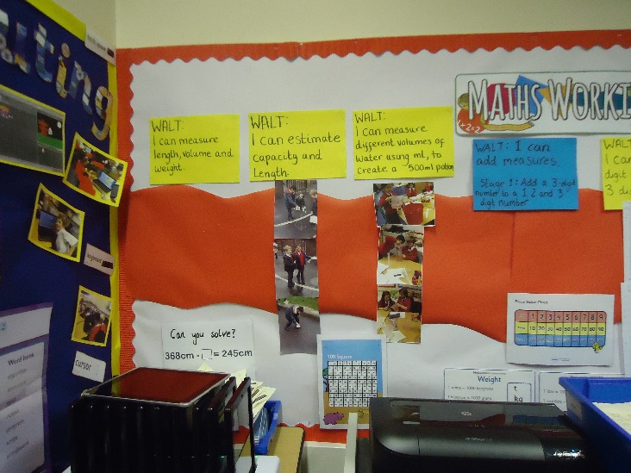
Partition to double and halve numbers
25 + 4 = 29
Know that division is the inverse of multiplication, e.g. that x 3 = 21 ≡ 21 ÷ 3 = ?
Recognise and derive equivalent fractions for ½, ¼, ¾, e.g. ¼ ≡ ³/₁₂.
Find unit and non-unit fractions of small amounts.
Add and subtract easy amounts of money, e.g. £3.64 + £4.50, and give change by counting up, e.g. £10 – £6.95 as £6.95 + 5p + £3 so change is £3.05.
Compare durations of events using analogue and digital times.
Know that there are 100cm in a metre and that there are 10mm in a centimetre; use a ruler to measure lines.
Identify right angles as 90⁰ in shapes, and also as turns; recognise angles as less than or greater than 90⁰; identify horizontal and vertical lines.

Slide 47
Year 4
By the end of year 4, children should be able to confidently:
Locate 4 and 5 digit numbers on a landmarked line and use this to compare and order numbers; round to ten, a hundred and a thousand.
Understand the numbers of 1s, 10s, 100s, 1000s and 10,000s in a 5-digit number and the use of zero as a place holder.
Know that one-place decimal numbers represent ones and tenths e.g. 3.7 = 3 ones and 7 tenths.
Count in steps of 2, 4, 5, 10, 50, 100 and 1000.
Recognise negative numbers in relation to number lines and temperature.
Add multiples of 1, 10, 100, 1000 without difficulty, e.g. 15,347 + 3000, 434 + 300 and 648 – 220
Mentally add and subtract any pair of two digit numbers
Subtract 3 digit numbers from 3 digit numbers
Multiply 1 and 2 digit numbers by 10, 100 and 1000; divide 1 and 2 digit numbers by 10 and 100 to understand place value in decimal numbers with one place.
Know and recite 2x, 3x, 4x, 5x, 9x, 10x times tables incl. division facts up to 12th multiple; include multiplying by 0 (e.g. 5 x 0 = 0, 7 x 0 = 0) or by 1 (e.g. 5 x 1 = 5, ½ x 1 = ½).
Multiply 1- digit numbers by 2-digit or friendly 3-digit numbers using grid method.
Know how to use ‘efficient chunking’ for division above the range of the tables’ facts
Write the equivalent fraction for fractions with given denominators or numerators, e.g. ½ = ?/₈; reduce a fraction to its simplest form, e.g. ⁶/₁₂ ≡ ½.
Convert between units of measurement, e.g. cm to m, g to Kg and ml to L; convert between units of time and between analogue and digital times.
Identify acute and obtuse angles, compare and order angles up to 180⁰.
Interpret and present discreet data using bar charts and pictograms.

Slide 48
Year 5
By the end of year 5, children should be able to confidently:
Locate 5 and 6 digit numbers on a landmarked line; use this to compare/order numbers.
Round to ten, a hundred, a thousand or ten thousand.
Begin to read scales of different types
Understand a one-place decimal number as a number of tenths and a two-place decimal number as a number of hundredths.
Understand the effect of multiplying and dividing by 10 and 100 to give 1-place and 2-place decimal answers. E.g. 4.5 x 10 = 45, and 678 ÷ 100 = 6.78 etc.
Add or subtract 0.1 or 0.01 to/from any decimal number with confidence, e.g. 5.83 + 0.01 or 4.83 – 0.1
Add and subtract mentally with confidence – where the numbers are less than 100 or the calculation relies upon simple addition/subtraction and place value. Examples include: 6,723 – 400, 78 + 46, 72 – 46, 8020 + 910, 100 – 64, 5000 + 12,000, etc.
Confidently add 3- and friendly 4-digit numbers together using a secure written method, including adding ‘piles’ of numbers
Subtract larger numbers using expanded column subtraction
Know and recite all times tables including division facts.
Multiply 2- and 3-digit numbers by numbers ≤12 using grid method; multiply 2-digit by 2-digit numbers using grid method.
Scale up or down by a factor of 2, 5 or 10
Perform divisions mentally within the range of tables facts using remainders and fractions and decimal equivalences, e.g. 68 ÷ 8 = 8 r4 or 8½ or 8.5
Divide 2-digit and 3-digit numbers by one-digit numbers above the range of tables using efficient chunking.
Reduce fractions to their simplest form, including tenths to fifths and hundredths to tenths, e.g. 40/100 = 4/10 = 2/5 which is also 0.4
Identify simple fraction and decimal equivalents: ½ ≡ 0.5, 0.25 ≡ ¼ and 0.75 ≡ ¾.
Measure and compare capacities, weights and lengths, including perimeters using SI units; understand the concept of area and count squares to find areas.
Understand the properties of triangles; find unknown angles in triangles and rectangles.

Slide 49
Year 6
By the end of year 6, children should be able to confidently:
Locate numbers up to 999,999 on a landmarked line; use this to compare/order numbers.
Round to ten, a hundred and a thousand, ten thousand or one hundred thousand.
Read scales with accuracy and confidence
Add and subtract mentally with confidence – where the numbers are less than 100 or the calculation relies upon simple addition/subtraction and place value. Examples include: 6,723 – 400, 78 + 46, 72 – 46, 8020 + 910, 100 – 64, 5000 + 12,000, etc.
Multiply numbers up to 20 by single-digit numbers mentally or using grid method.
Multiply 3-digit by numbers up to 12
Multiply 2-digit numbers by 2-digit or 3-digit numbers using grid method
Scale up or down by a factor of 2, 5 or 10
Perform divisions mentally within the range of tables facts using remainders or rounding the answer up or down as appropriate, e.g. 68 ÷ 8 = 8 r4 or 8½ or how many toy spiders can be made if I have 68 legs? (Ans = 8) or how many minibuses each holding 8 children will be needed to transport 68 children? (Ans = 9).
Divide 3-digit by one-digit numbers using chunking.
Recognise equivalent fractions, e.g. ⁴/₈ = ½; reduce fractions to their simplest form
Identify simple fraction/decimal equivalents: ½ = 0.5, ¼ = 0.25, ¾ = 0.75, ¹/₃ = 0.33, etc.
Understand that if two numbers less than 1 are multiplied, the answer is smaller than either of them.
Calculate simple percentages of whole numbers.
Add several large or decimal numbers using written addition
Subtract large numbers using decomposition

Slide 50
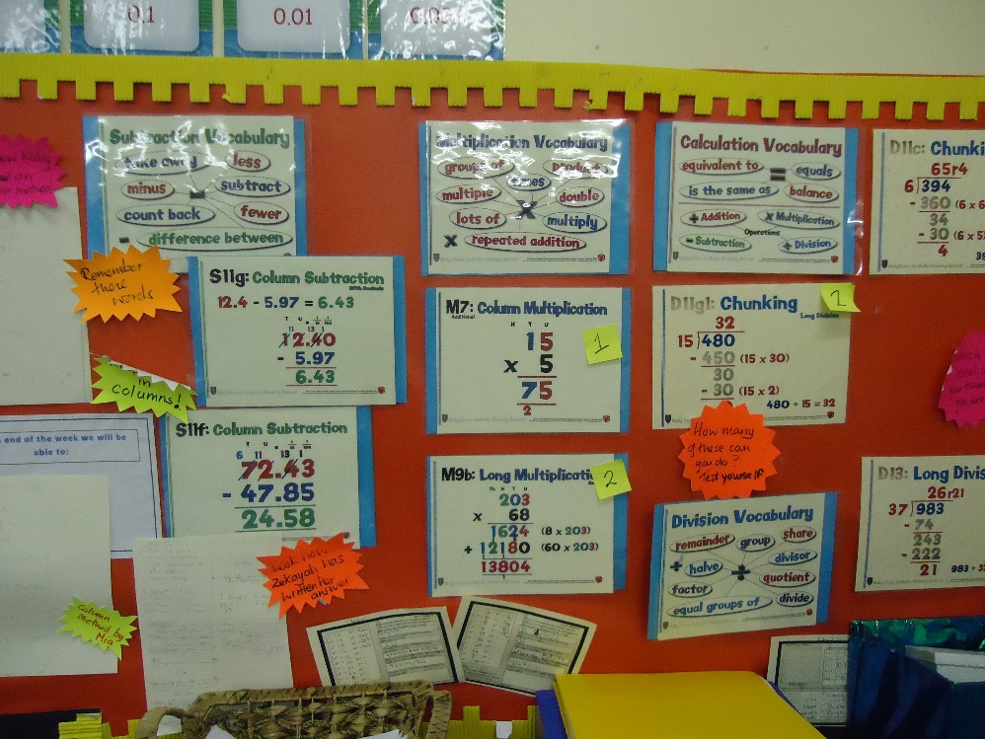
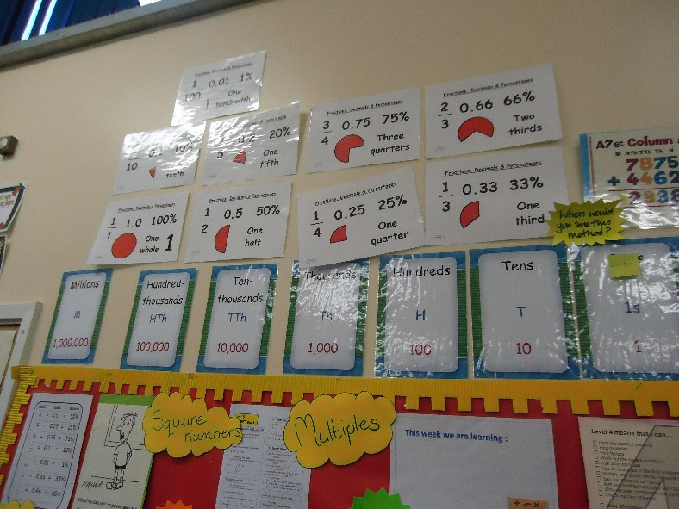
Solve missing number problems.
Generate and describe linear sequences.
Use, read and write, and convert between, standard units.
Measure areas and perimeters; understand that area is a measurement of covering and is measured in square units, and perimeter is a length, measured in cm, m or mm.
Use 12 and 24 hour clocks; calculate time intervals; use timetables.
Compare and classify geometric shapes; identify circles and parts of circles.
Identify positions in the first and fourth quadrants on a co-ordinate grid; reflect and translate shapes.
Find and interpret the mean (average) of several quantities.

Slide 51
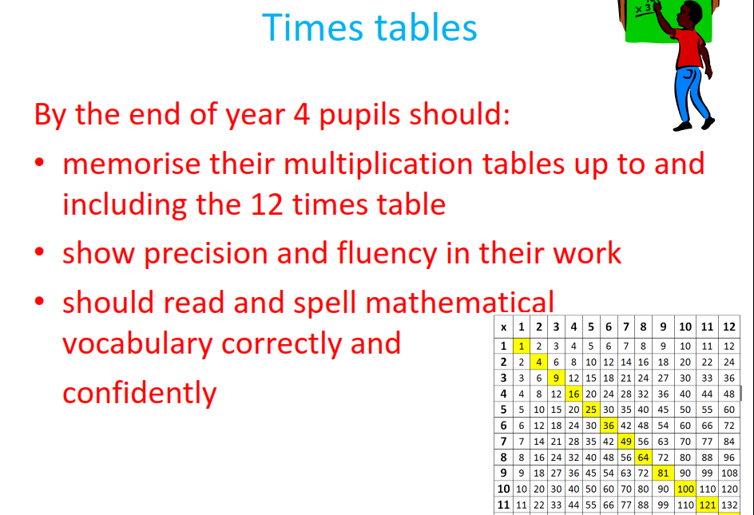

Slide 53
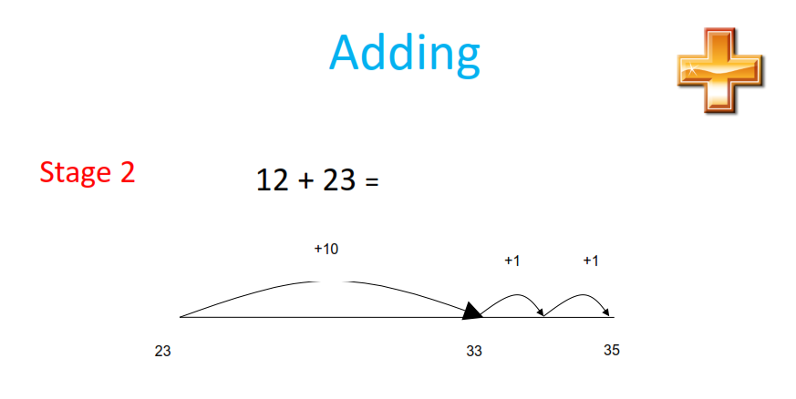

Slide 54
72-27=
174 – 27=

Slide 55
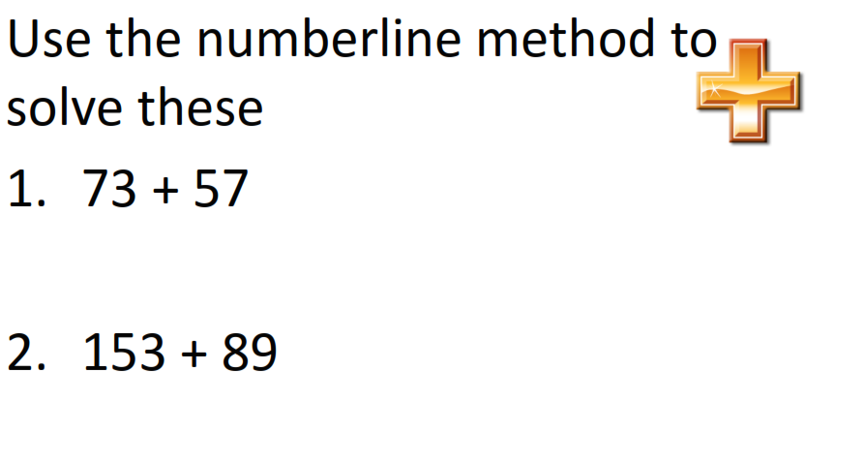

Slide 56
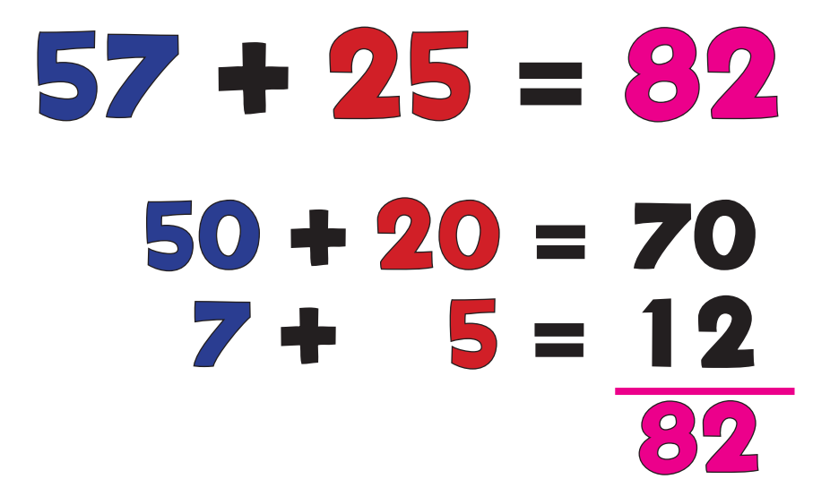

Slide 57
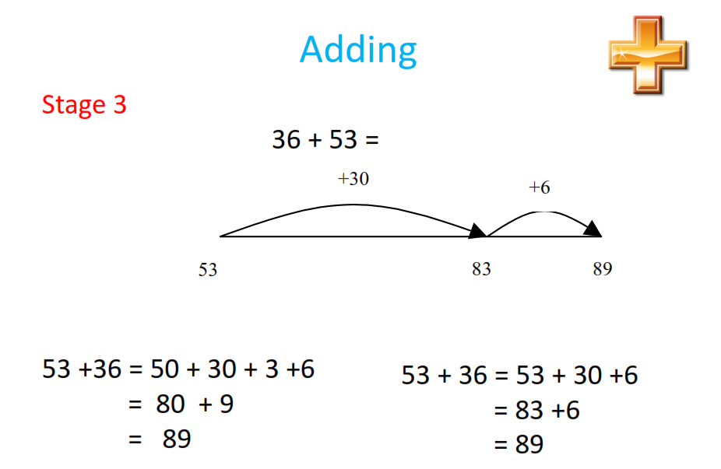
Year 2/3

Slide 58
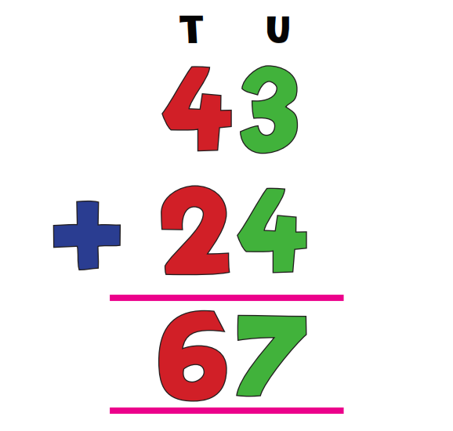


Slide 59



Slide 60


Slide 62


Slide 63

Year 3/4

Slide 64


Slide 65


Slide 66

Year 3/4

Slide 67

Solve these using the
Exchange method

Slide 68

Solve these using partitioning methods

Slide 69


Slide 70


Slide 71


Slide 72

Year 5/6

Slide 73


Slide 74


Slide 75


Slide 76


Slide 77
948 divided by 24
986 divided by 24

Slide 78


Slide 79


Slide 80

Year 3/4

Slide 81


Slide 82



Slide 83


Slide 84
Supermarket maths
Target practice
School website
Woodlands Junior School
Mathsletics
Purplemash
Maths is fun
Maths boot camp

Slide 85


