Slide 1
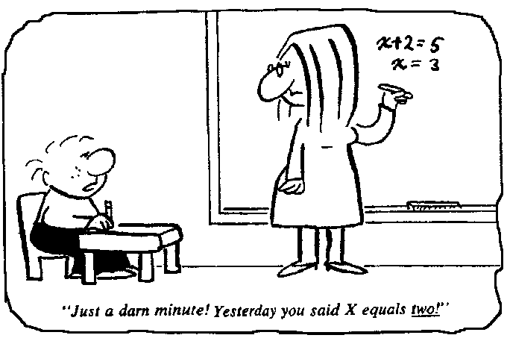
Maths Workshop for Parents

Slide 2
Aims of the workshop
Over the course of the workshop, we will be thinking about:
Our own experiences of maths
Considering the difficulties children might encounter when learning maths
The key features of maths teaching
Games and ideas you can use at home to support children’s maths development.
Provide and help and support you need with Maths
Looking at Year 2 SATs questions

Slide 3
What do we think about maths?
What do you think of when you hear the word ‘maths’?
Think back to your own experiences of learning maths.
Notes:
So what was maths like for you at school. Maybe you loved maths. Maybe you hated it. Well if you’re like most people, when somebody mentions maths to adults, they immediately think back to the time they were at school and if we just briefly look at what maths was like 30/40 years ago, it was very much about teaching methods. Certainly when I was at school, I remember spending a lot of time completing row of sums, I used to queue up at the teachers desk and either look forward to getting lots of red ticks when I got the addition but the moment we went onto subtraction and decomposition, my book looked very different! And when we went onto long multiplication and division, I just hoped that I was sitting next to someone who knew what they were doing.

Slide 4
How things have changed
In the past when we were at school, a lot of time was given to practising methods.
But research has shown that children found certain methods difficult, forgot them quickly and made persistent errors.
The days of maths lessons being pages of endless sums
done in silence, are for the most part gone.
Notes:
Today’s lessons are far more concerned with investigation and collaboration – lessons are busy and active!
Teaching methods have also changed – children now learn how and why a method works, rather than simply the method itself.

Slide 5
What do we learn from this?
Today’s teaching methods are not just about getting the right answer, but more about understanding how the method you used works and trying to develop children’s number sense
There’s always more than one way to work something out!
Different methods suit different learning styles.

Slide 6
Good practice in Maths today
The new National Curriculum for maths aims to ensure that all pupils:
Become fluent in the fundamentals of mathematics
Reason mathematically by following a line of enquiry... and developing an argument, justification or proof using mathematical language
Can solve problems by applying their maths to a variety of problems.

Slide 7
Good practice in Maths today
Teaching methods have changed – children now learn how and why a method works, rather than simply the method itself.
Today’s lessons are far more concerned with investigation and collaboration – lessons are busy and active.
Problem solve in a real life context and apply maths to do so.

Slide 8
Current expectations
Content has generally become more challenging and expectations have been raised.
Fewer things in more depth – ‘mastery’
Firmer foundations with less acceleration
Earlier and more challenging requirements for multiplication tables
More emphasis on problem solving and reasoning, using mathematical vocabulary to communicate, justify or prove

Slide 9
Year 1 and 2 expectations
You can view the expectations for your children in Year 1 and 2 on the school website. You can take a copy of these expectations from the session today.

Slide 10
Addition
When beginning to learn to add 2 numbers or amounts, most children use a strategy called ‘counting all’
In Y1 children are taught to relate addition to ‘counting on’ and they begin to use a number line alongside practical resources to support addition
Notes:
Counting on is an important skill because it is time-consuming and impractical to recount a group of items each time additional pieces are added.

Slide 11

Counting on using a number line
+ 3 =
Notes:
Addition can be done in any order and will still achieve the same total - COMMUTATIVITY

Slide 12
Partitioning
Splitting a number into its tens and ones (or units as we used to call them) and understanding the worth of each digit.
In school we use a variety of equipment (known as manipulatives) that illustrates this.

Slide 13
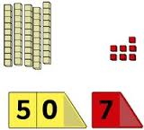


Partitioning

Slide 14
Number bonds
During Year 1, your child will start to learn their number bonds to 10.
Really useful facts for your child to learn and remember
Lots of different manipulatives to help them practise and recall these

Slide 15
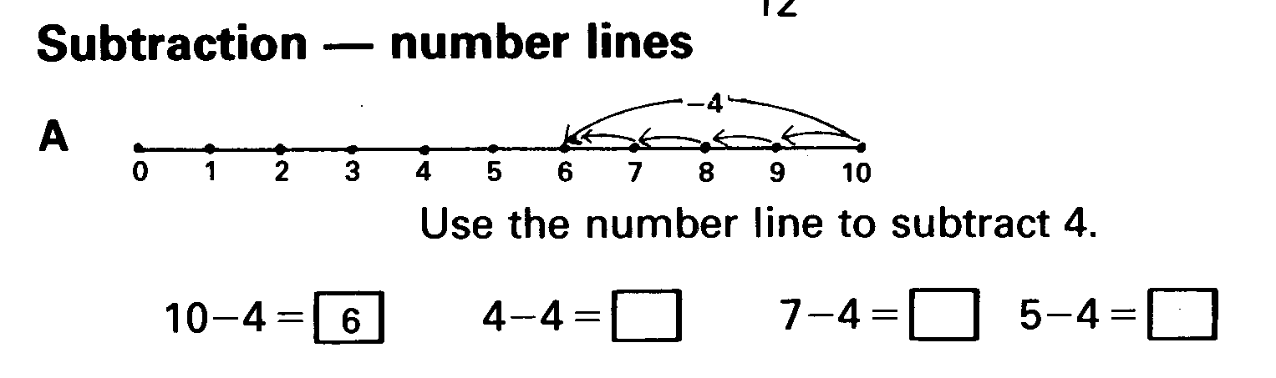
Subtraction
Learning about subtraction in a broader sense.
Still working with manipulatives
Using a number line to subtract
The number line (and later the 100 square), helps children to use counting back as a means of calculating

Slide 16
Early Multiplication
Multiplication as repeated addition
4 + 4 + 4 = 12
3 groups of 4 OR 3 x 4 = 12

Slide 17
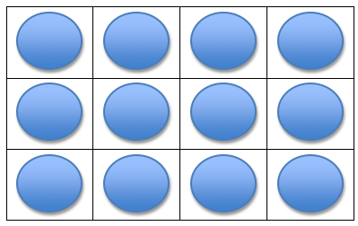
Early Multiplication
Arrays are useful models for multiplication
An array is formed by arranging a set of objects into rows and columns.

Slide 18
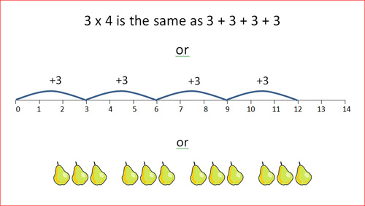
Early Multiplication

Slide 19
Early Division
Division is initially done practically using real objects and then manipulatives, and then represented pictorially.
It can be done by sharing eg:
6 sweets shared equally between 2 people. How many each?
6 ÷ 2 =

Slide 20
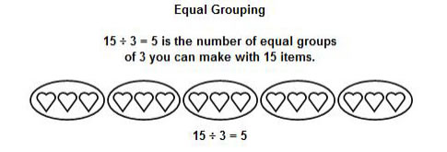
Early Division
…. Or by grouping :
They are two different concepts.

Slide 21
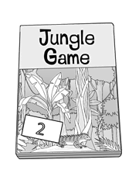
Examples of past Y2 SATS questions
There are sixty-three bean bags in a sack. Amy takes ten bean bags away. How many bean bags are left in the sack?
A game costs £25. Ben has £19. How much more money does Ben need to buy the game?

Slide 22

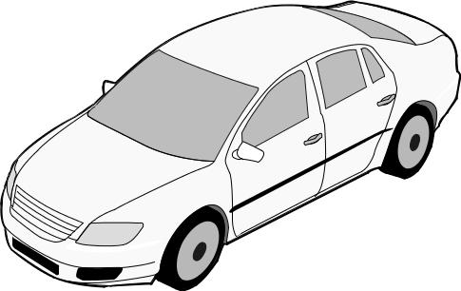
There are 55 cakes.
20 boys and 19 girls each take a cake.
How many cakes are left?
There are 76 cars in the car park.
18 more cars go into the car park.
Then 35 cars go out.
How many cars are in the car park now?

Slide 23
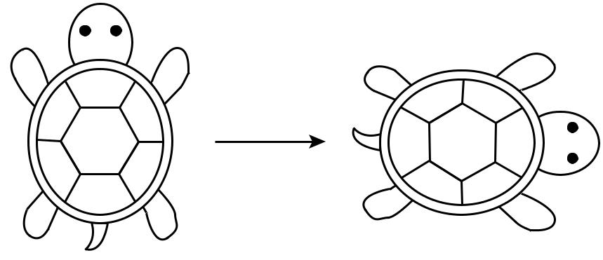
This turtle is rotated clockwise.
How much is the turtle rotated? Circle your answer.
quarter half three-quarter full
turn turn turn turn

Slide 24

How to Help Your Child with Year 2 SATS
First and foremost, support and reassure your child that there is nothing to worry about and they should always just try their best. Praise and encourage!
Ensure your child has the best possible attendance at school.
Support your child with any homework tasks. CGP books are excellent practise!
Arithmetic (adding, subtracting, etc.) is always good to practise.
Talk to your child about what they have learnt at school.
Make sure your child has a good sleep and healthy breakfast every morning!

Slide 25
How to Help Your Child with Maths
Play number games.
Play mental maths games including counting in different amounts, forwards and backwards.
Encourage opportunities for telling the time.
Encourage opportunities for counting coins and money; finding amounts or calculating change when shopping.
Look for numbers on street signs, car registrations and anywhere else!
Look for examples of 2D and 3D shapes around the home.
Identify, weigh or measure quantities and amounts in the kitchen or in recipes.
Play games involving numbers or logic, such as dominoes, card games, darts, draughts and chess.

Slide 26
Top tips for parents and families:
Be positive about maths. Don't say things like "I can’t do maths" or "I hated maths at school“ in front of your child; your child might start to think like that themselves.
Point out the maths in everyday life. Include your child in activities involving maths such as using money, cooking and travelling.
Praise your child for effort rather than talent - this shows them that by working hard they can always improve.
If you struggle with maths yourself - try this free online tool the National Numeracy Challenge to improve your maths level.

Slide 27
Activity ideas to do at home to improve your child’s maths skills.
Try a parent maths challenge or arithmetic questions with my support.
Look at examples of Year 2 SATS questions – you can take these home.
Don’t forgot to take the hand outs.
Handouts include the expectations for Year 1 and 2.
Please make sure you have signed in and fill an evaluation form before you leave.
HAVE FUN and THANK YOU! ☺

